Slide 1
Chapter 4
The Processor
Notes:
Morgan Kaufmann Publishers
Chapter 4 — The Processor

Slide 2
Introduction
§4.1 Introduction
CPU performance factors
  Instruction count
    Determined by ISA and compiler
  CPI and Cycle time
    Determined by CPU hardware
We will examine two RISC-V implementations
  A simplified version
  A more realistic pipelined version
Simple subset, shows most aspects
  Memory reference: ld, sd
  Arithmetic/logical: add, sub, and, or
  Control transfer: beq
Chapter 4 — The Processor — <number>
Notes:
Morgan Kaufmann Publishers
Chapter 4 — The Processor

Slide 3
Instruction Execution
PC → instruction memory, fetch instruction
Register numbers → register file, read registers
Depending on instruction class
  Use ALU to calculate
    Arithmetic result
    Memory address for load/store
    Branch comparison
  Access data memory for load/store
  PC ← target address or PC + 4
Chapter 4 — The Processor — <number>
Notes:
Morgan Kaufmann Publishers
Chapter 4 — The Processor

Slide 4
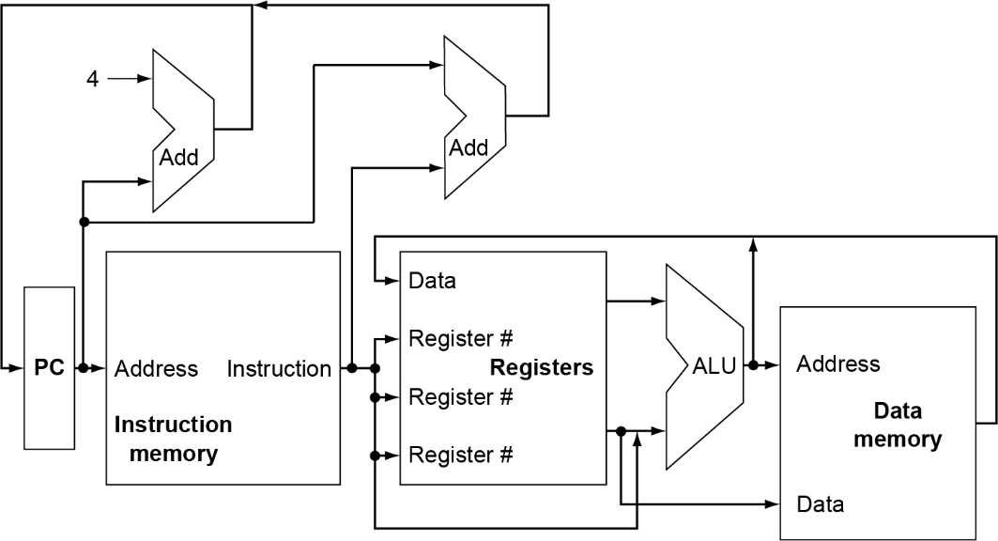
CPU Overview
Chapter 4 — The Processor — <number>
Notes:
Morgan Kaufmann Publishers
Chapter 4 — The Processor

Slide 5
Multiplexers
Can’t just join wires together
  Use multiplexers
Chapter 4 — The Processor — <number>
Notes:
Morgan Kaufmann Publishers
Chapter 4 — The Processor

Slide 6
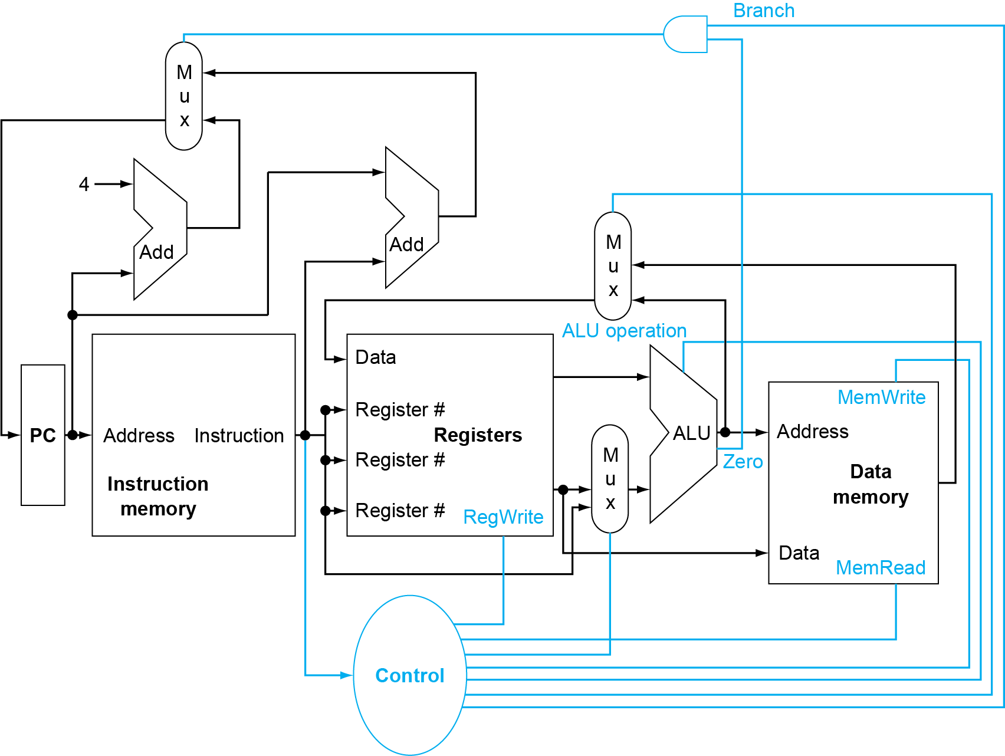
Control
Chapter 4 — The Processor — <number>
Notes:
Morgan Kaufmann Publishers
Chapter 4 — The Processor

Slide 7
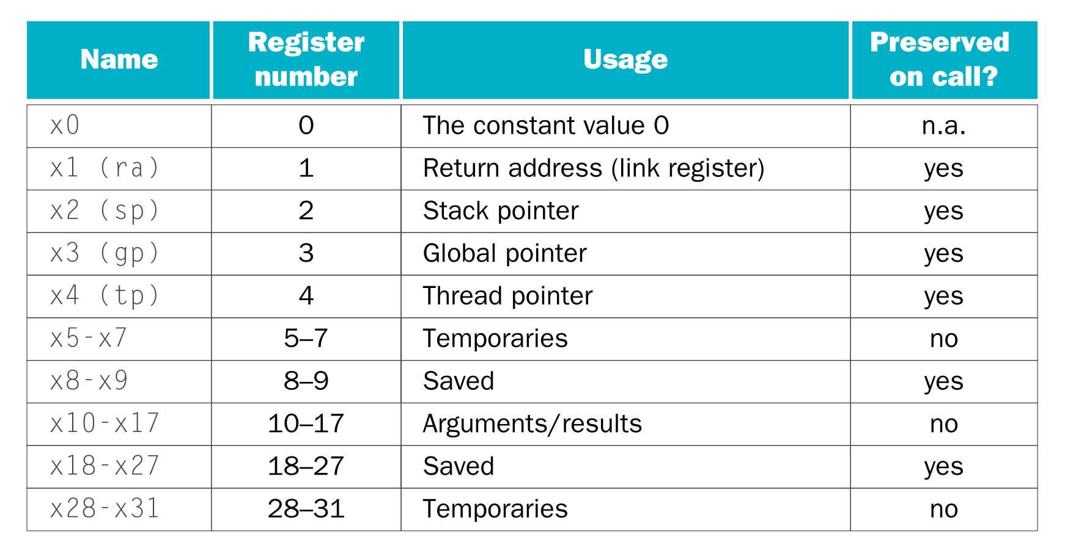
Basic RISC-V Registers
Chapter 4 — The Processor — <number>

Slide 8
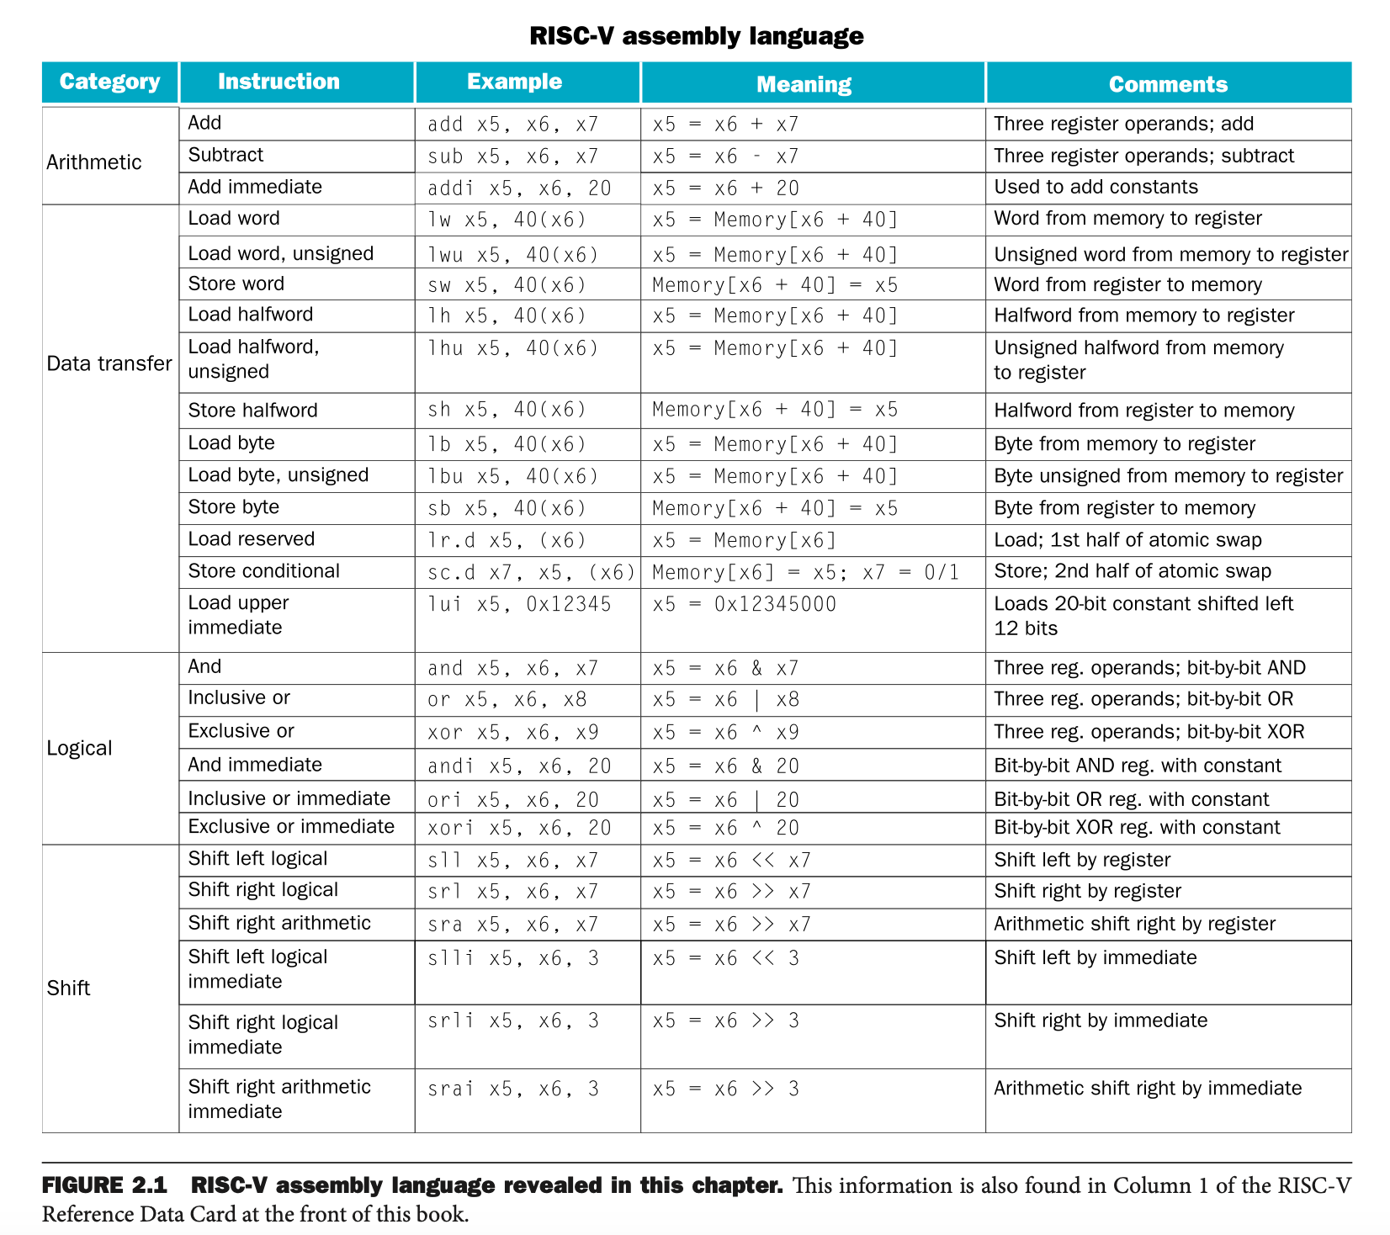
Chapter 4 — The Processor — <number>

Slide 9
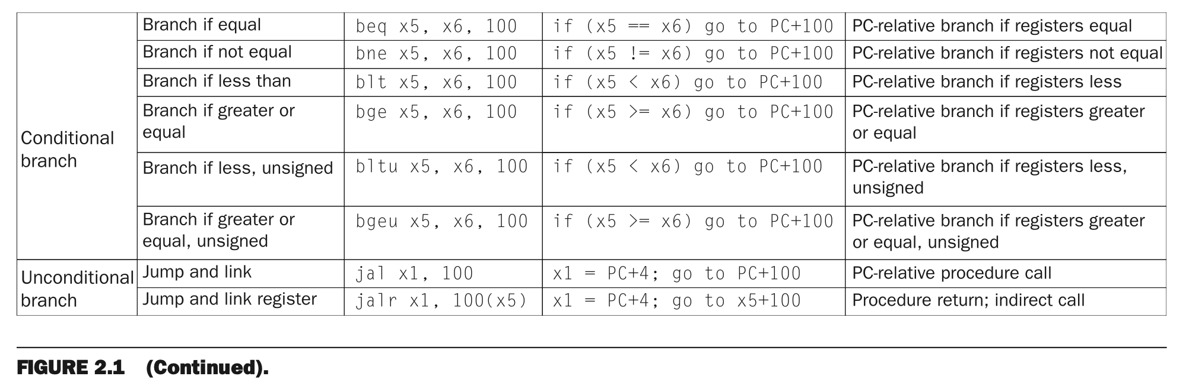
RISC-V Assembly Language
Chapter 4 — The Processor — <number>

Slide 10
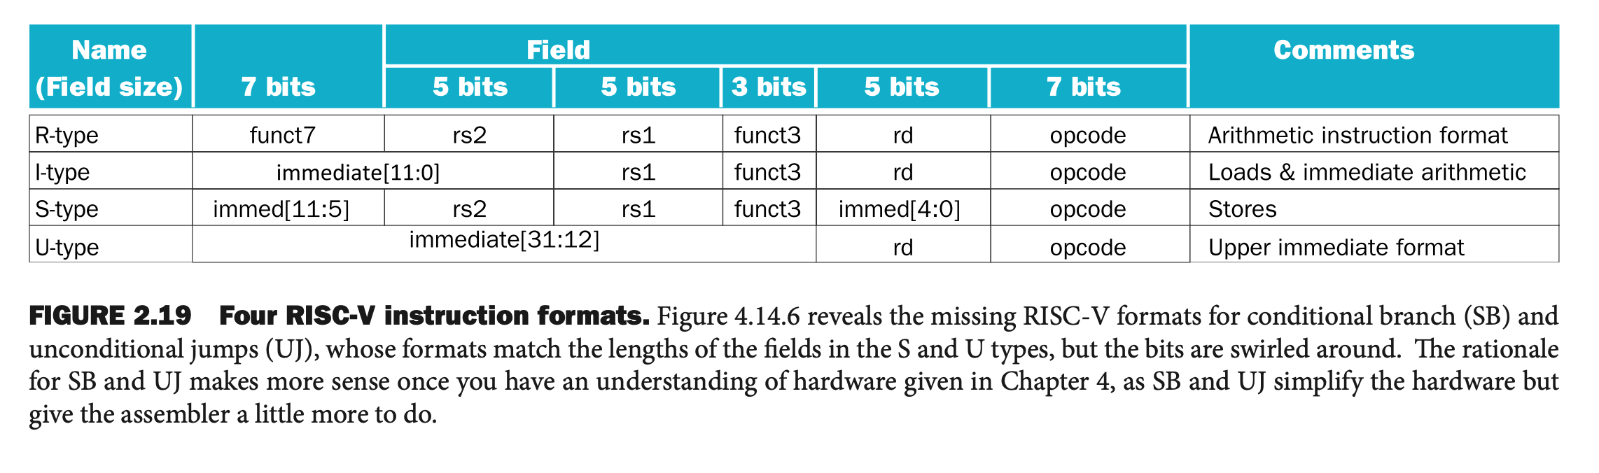
Chapter 4 — The Processor — <number>

Slide 11
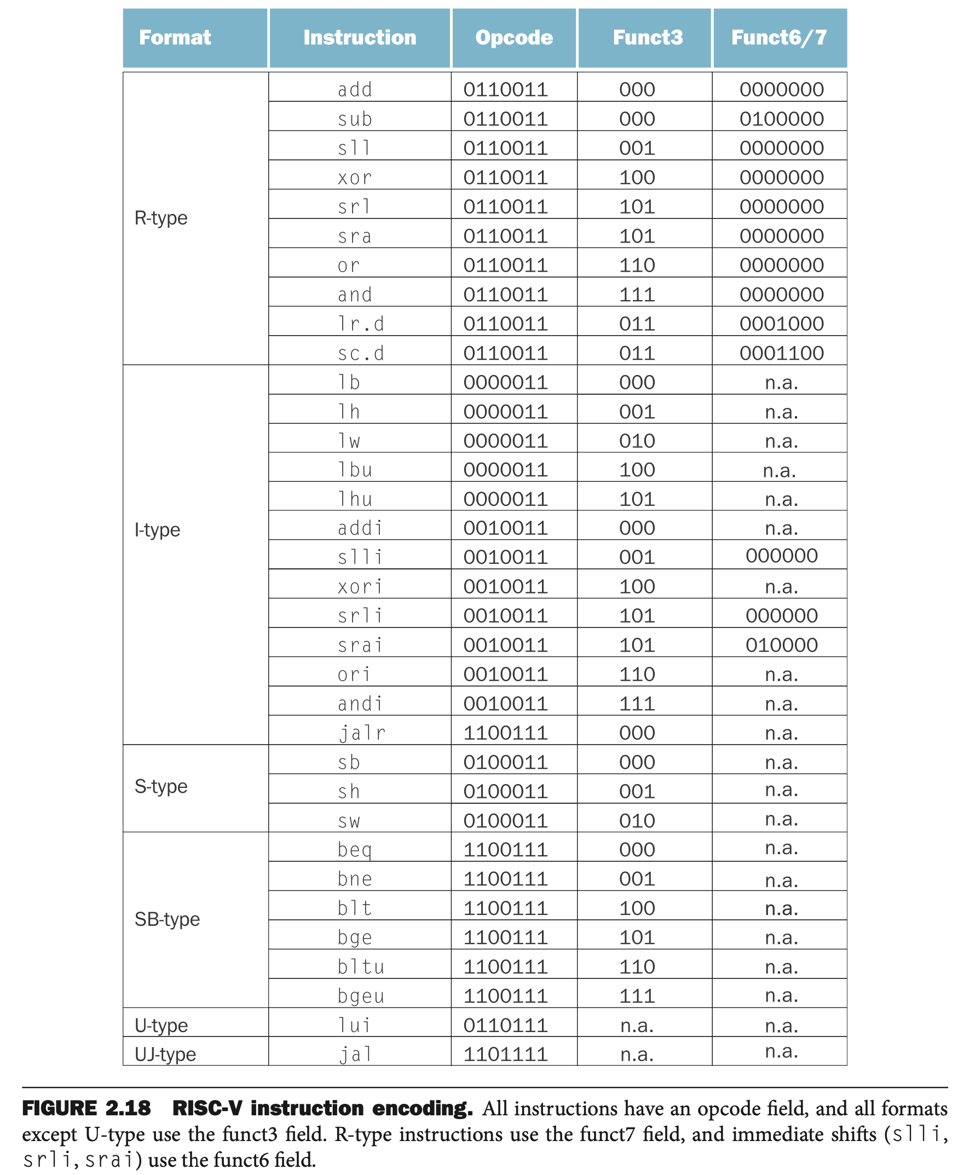
Chapter 4 — The Processor — <number>

Slide 12
Performance Issues
Longest delay determines clock period
  Critical path: load instruction
  Instruction memory → register file → ALU → data memory → register file
Not feasible to vary period for different instructions
Violates design principle
  Making the common case fast
We will improve performance by pipelining
Chapter 4 — The Processor — <number>
Notes:
Morgan Kaufmann Publishers
Chapter 4 — The Processor

Slide 13
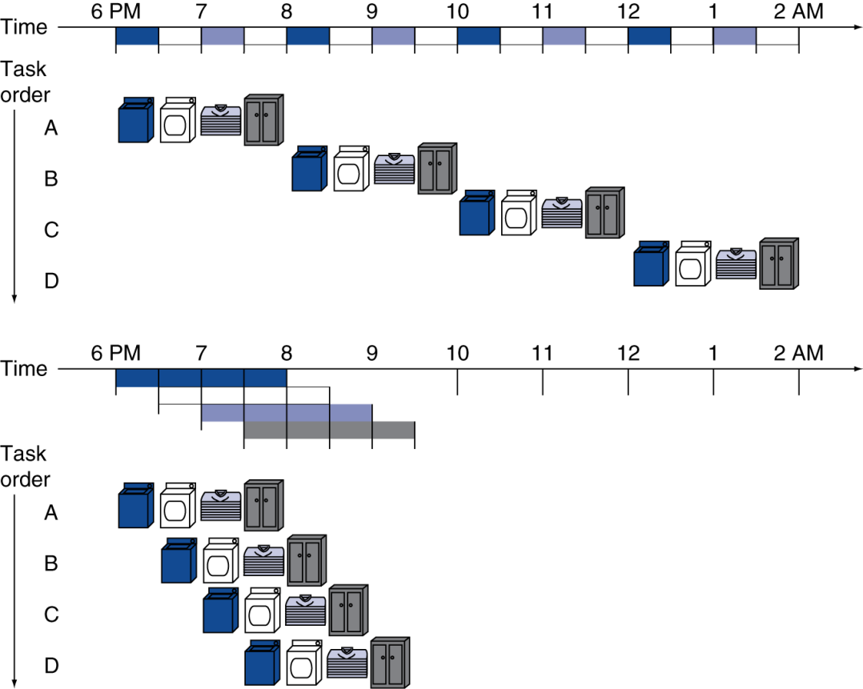
Pipelining Analogy
Pipelined laundry: overlapping execution
  Parallelism improves performance
§4.6 An Overview of Pipelining
Four loads:
  Speedup
  = 8/3.5 = 2.3
Non-stop:
  Speedup
  = 2n/0.5n + 1.5 ≈ 4
  = number of stages
Chapter 4 — The Processor — <number>
Notes:
Morgan Kaufmann Publishers
Chapter 4 — The Processor

Slide 14
RISC-V Pipeline
Five stages, one step per stage
  IF: Instruction fetch from memory
  ID: Instruction decode & register read
  EX: Execute operation or calculate address
  MEM: Access memory operand
  WB: Write result back to register
Chapter 4 — The Processor — <number>
Notes:
Morgan Kaufmann Publishers
Chapter 4 — The Processor

Slide 15
Pipeline Performance
Assume time for stages is
  100ps for register read or write
  200ps for other stages
Compare pipelined datapath with single-cycle datapath
Instr | Instr fetch | Register read | ALU op | Memory access | Register write | Total time
ld | 200ps | 100 ps | 200ps | 200ps | 100 ps | 800ps
sd | 200ps | 100 ps | 200ps | 200ps |  | 700ps
R-format | 200ps | 100 ps | 200ps |  | 100 ps | 600ps
beq | 200ps | 100 ps | 200ps |  |  | 500ps
Chapter 4 — The Processor — <number>
Notes:
Morgan Kaufmann Publishers
Chapter 4 — The Processor

Slide 16
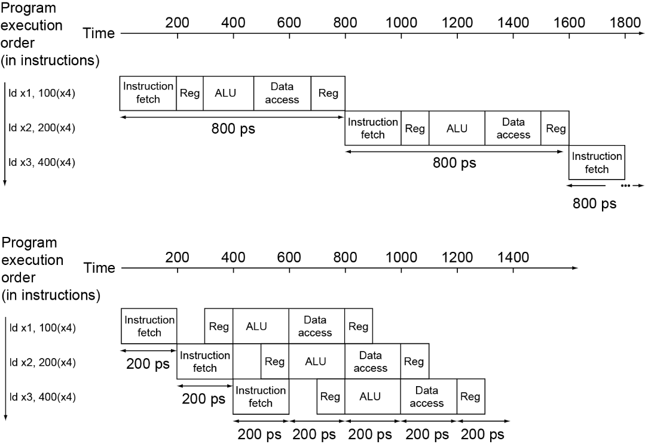
Pipeline Performance
Single-cycle (T_{c}= 800ps)
Pipelined (T_{c}= 200ps)
Chapter 4 — The Processor — <number>
Notes:
Morgan Kaufmann Publishers
Chapter 4 — The Processor

Slide 17
Pipeline Speedup
If all stages are balanced
  i.e., all take the same time
  Time between instructions_{pipelined}
  = Time between instructions_{nonpipelined}
  Number of stages
If not balanced, speedup is less
Speedup due to increased throughput
  Latency (time for each instruction) does not decrease
Chapter 4 — The Processor — <number>
Notes:
Morgan Kaufmann Publishers
Chapter 4 — The Processor

Slide 18
Pipelining and ISA Design
RISC-V ISA designed for pipelining
  All instructions are 32-bits
    Easier to fetch and decode in one cycle
    c.f. x86: 1- to 17-byte instructions
  Few and regular instruction formats
    Can decode and read registers in one step
  Load/store addressing
    Can calculate address in 3rd stage, access memory in 4th stage
Chapter 4 — The Processor — <number>
Notes:
Morgan Kaufmann Publishers
Chapter 4 — The Processor

Slide 19
Hazards
Situations that prevent starting the next instruction in the next cycle
Structure hazards
  A required resource is busy
Data hazard
  Need to wait for previous instruction to complete its data read/write
Control hazard
  Deciding on control action depends on previous instruction
Chapter 4 — The Processor — <number>
Notes:
Morgan Kaufmann Publishers
Chapter 4 — The Processor

Slide 20
Structural Hazards
Conflict for use of a resource
In RISC-V pipeline with a single memory
  Load/store requires data access
  Instruction fetch would have to stall for that cycle
    Would cause a pipeline “bubble”
Hence, pipelined datapaths require separate instruction/data memories
  Or separate instruction/data caches
Chapter 4 — The Processor — <number>
Notes:
Morgan Kaufmann Publishers
Chapter 4 — The Processor

Slide 21
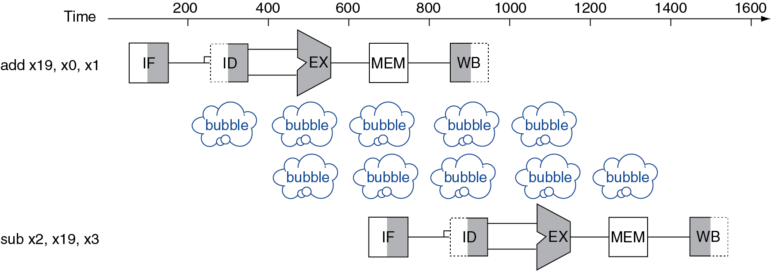
Data Hazards
An instruction depends on completion of data access by a previous instruction
  add x19, x0, x1
  sub x2, x19, x3
Chapter 4 — The Processor — <number>
Notes:
Morgan Kaufmann Publishers
Chapter 4 — The Processor

Slide 22
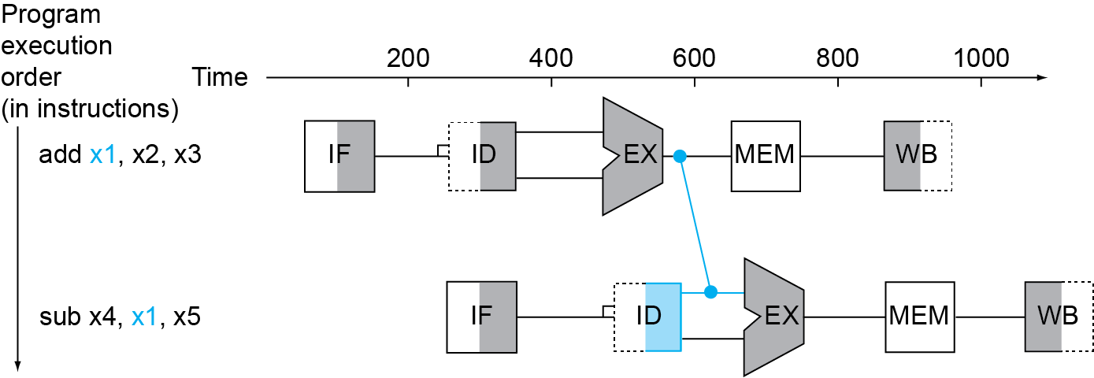
Forwarding (aka Bypassing)
Use result when it is computed
  Don’t wait for it to be stored in a register
  Requires extra connections in the datapath
Chapter 4 — The Processor — <number>
Notes:
Morgan Kaufmann Publishers
Chapter 4 — The Processor

Slide 23
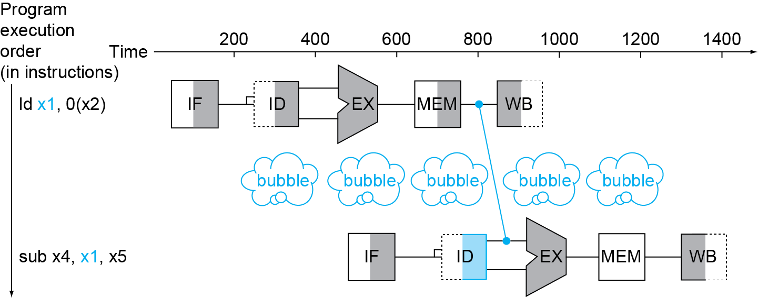
Load-Use Data Hazard
Can’t always avoid stalls by forwarding
  If value not computed when needed
  Can’t forward backward in time!
Chapter 4 — The Processor — <number>
Notes:
Morgan Kaufmann Publishers
Chapter 4 — The Processor

Slide 24
Code Scheduling to Avoid Stalls
Reorder code to avoid use of load result in the next instruction
C code for a = b + e; c = b + f;
ld x1, 0(x0)
ld x2, 8(x0)
add x3, x1, x2
sd x3, 24(x0)
ld x4, 16(x0)
add x5, x1, x4
sd x5, 32(x0)
ld x1, 0(x0)
ld x2, 8(x0)
ld x4, 16(x0)
add x3, x1, x2
sd x3, 24(x0)
add x5, x1, x4
sd x5, 32(x0)
stall
stall
13 cycles
11 cycles
Chapter 4 — The Processor — <number>
Notes:
Morgan Kaufmann Publishers
Chapter 4 — The Processor

Slide 25
Control Hazards
Branch determines flow of control
  Fetching next instruction depends on branch outcome
  Pipeline can’t always fetch correct instruction
    Still working on ID stage of branch
In RISC-V pipeline
  Need to compare registers and compute target early in the pipeline
  Add hardware to do it in ID stage
Chapter 4 — The Processor — <number>
Notes:
Morgan Kaufmann Publishers
Chapter 4 — The Processor

Slide 26
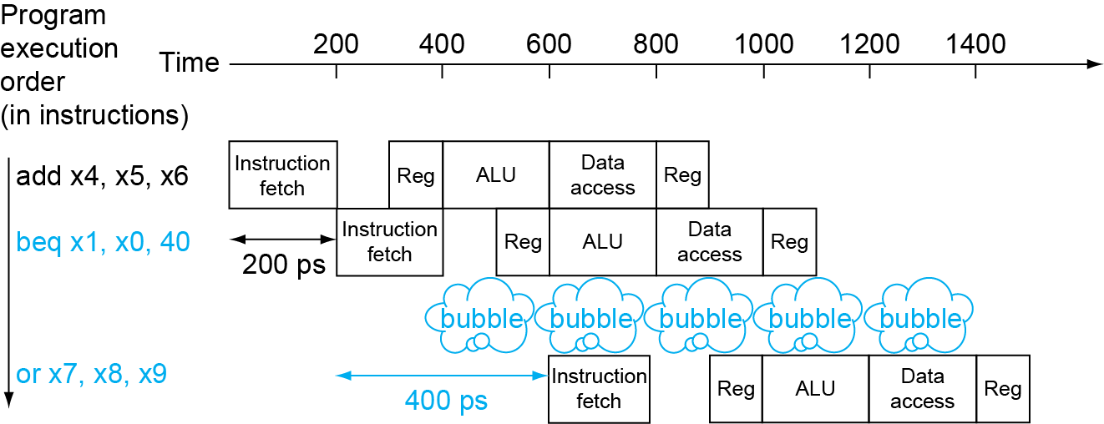
Stall on Branch
Wait until branch outcome determined before fetching next instruction
Chapter 4 — The Processor — <number>
Notes:
Morgan Kaufmann Publishers
Chapter 4 — The Processor

Slide 27
Branch Prediction
Longer pipelines can’t readily determine branch outcome early
  Stall penalty becomes unacceptable
Predict outcome of branch
  Only stall if prediction is wrong
In RISC-V pipeline
  Can predict branches not taken
  Fetch instruction after branch, with no delay
Chapter 4 — The Processor — <number>
Notes:
Morgan Kaufmann Publishers
Chapter 4 — The Processor

Slide 28
More-Realistic Branch Prediction
Static branch prediction
  Based on typical branch behavior
  Example: loop and if-statement branches
    Predict backward branches taken
    Predict forward branches not taken
Dynamic branch prediction
  Hardware measures actual branch behavior
    e.g., record recent history of each branch
  Assume future behavior will continue the trend
    When wrong, stall while re-fetching, and update history
Chapter 4 — The Processor — <number>
Notes:
Morgan Kaufmann Publishers
Chapter 4 — The Processor

Slide 29
Pipeline Summary
The BIG Picture
Pipelining improves performance by increasing instruction throughput
  Executes multiple instructions in parallel
  Each instruction has the same latency
Subject to hazards
  Structure, data, control
Instruction set design affects complexity of pipeline implementation
Chapter 4 — The Processor — <number>
Notes:
Morgan Kaufmann Publishers
Chapter 4 — The Processor

Slide 30
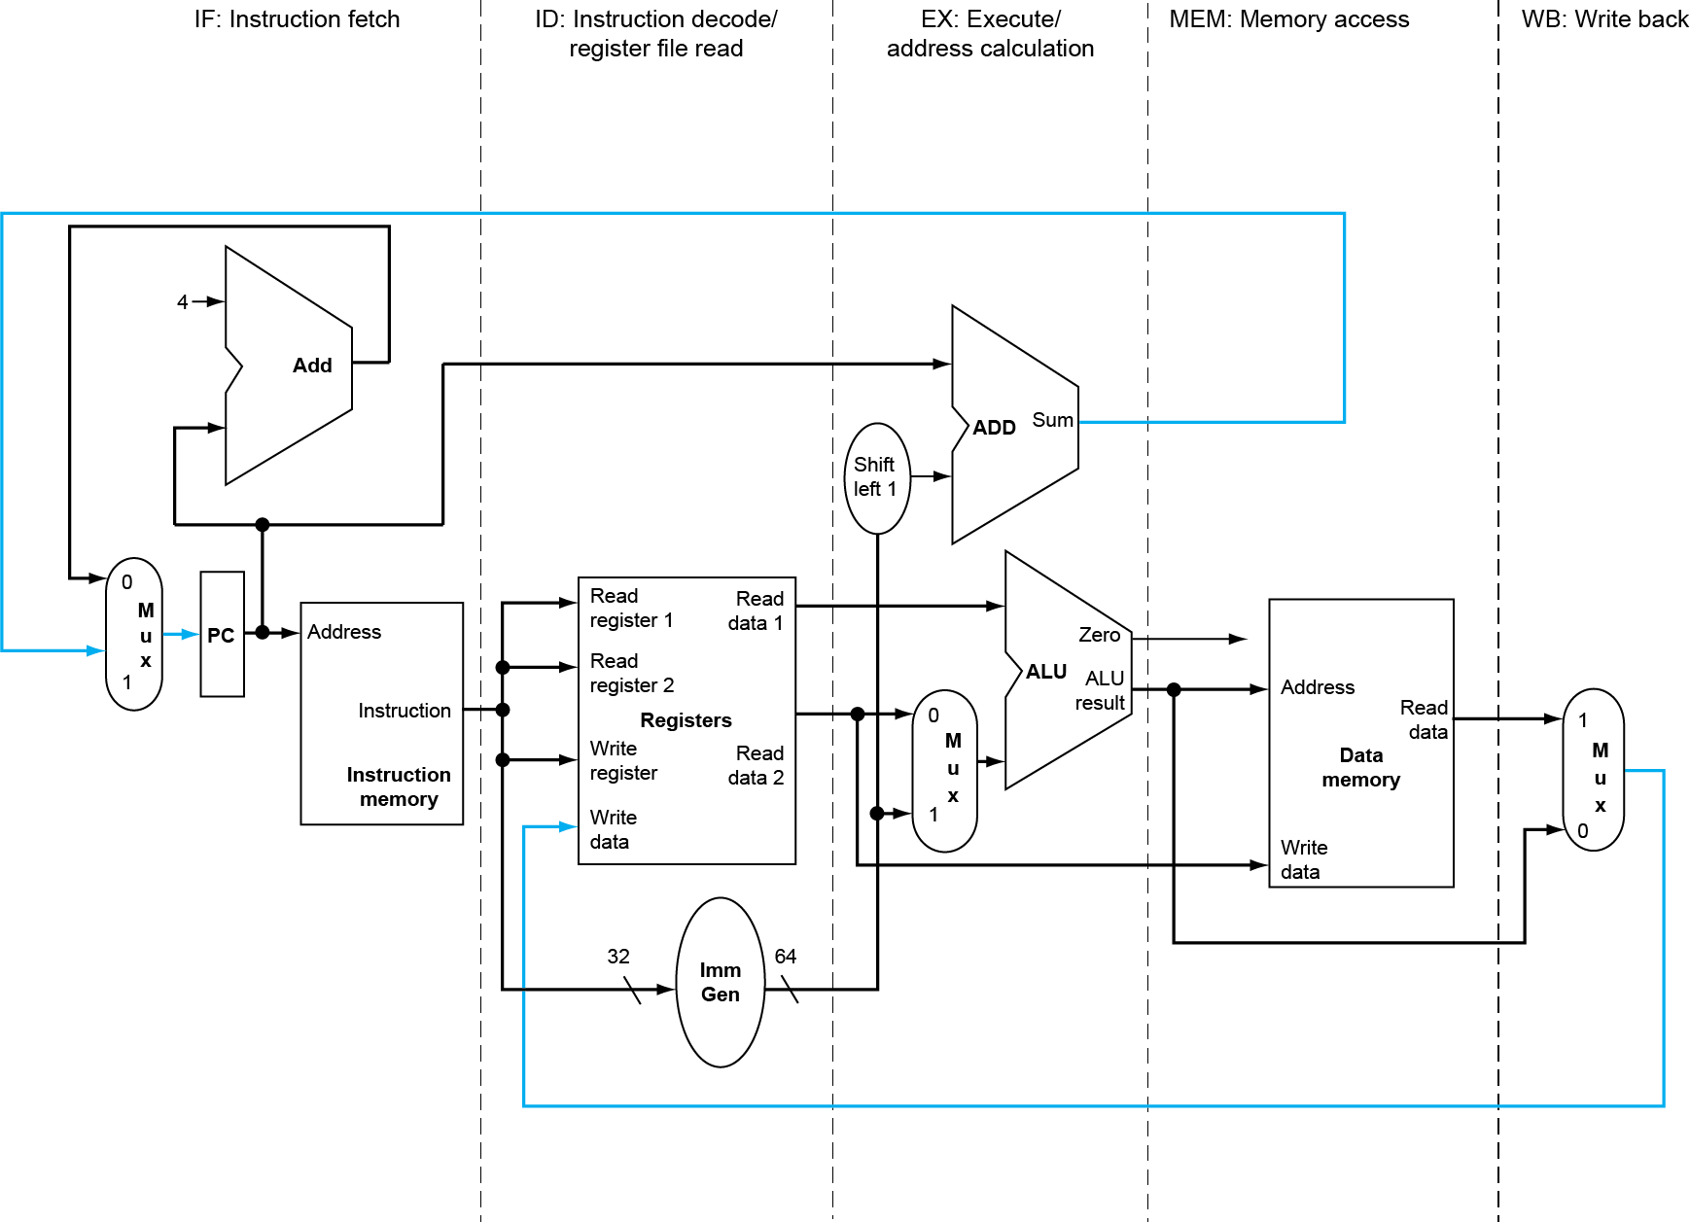
RISC-V Pipelined Datapath
§4.7 Pipelined Datapath and Control
MEM
Right-to-left flow leads to hazards
WB
Chapter 4 — The Processor — <number>
Notes:
Morgan Kaufmann Publishers
Chapter 4 — The Processor

Slide 31
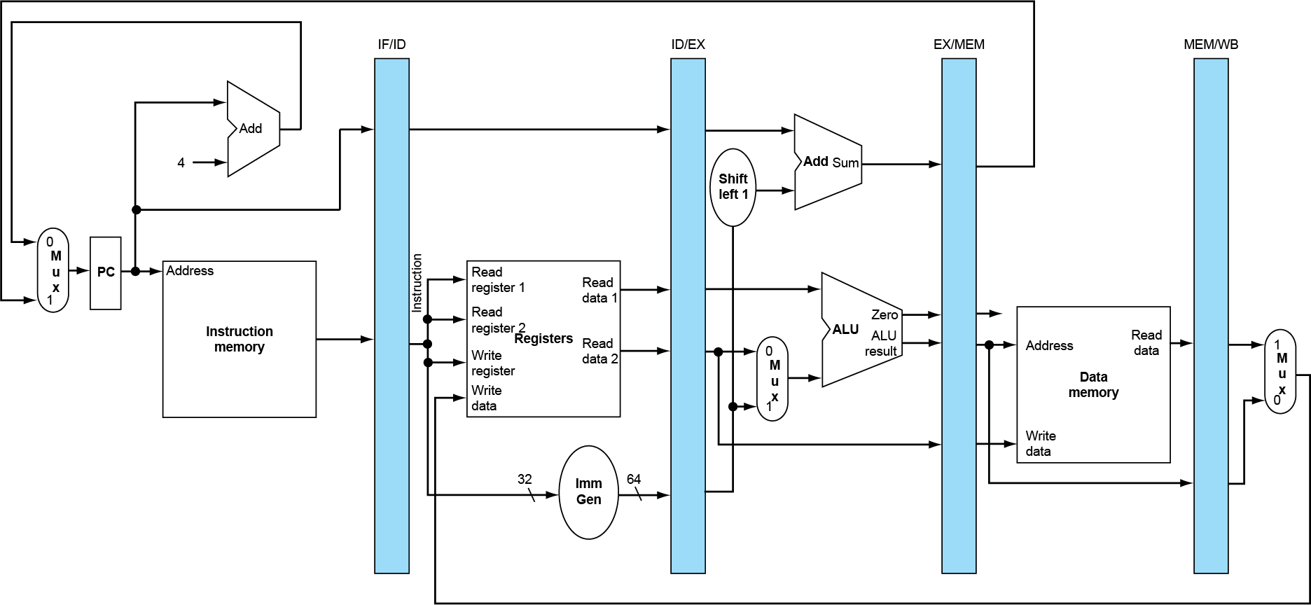
Pipeline registers
Need registers between stages
  To hold information produced in previous cycle
Chapter 4 — The Processor — <number>
Notes:
Morgan Kaufmann Publishers
Chapter 4 — The Processor

Slide 32
Pipeline Operation
Cycle-by-cycle flow of instructions through the pipelined datapath
  “Single-clock-cycle” pipeline diagram
    Shows pipeline usage in a single cycle
    Highlight resources used
  c.f. “multi-clock-cycle” diagram
    Graph of operation over time
We’ll look at “single-clock-cycle” diagrams for load & store
Chapter 4 — The Processor — <number>
Notes:
Morgan Kaufmann Publishers
Chapter 4 — The Processor

Slide 33
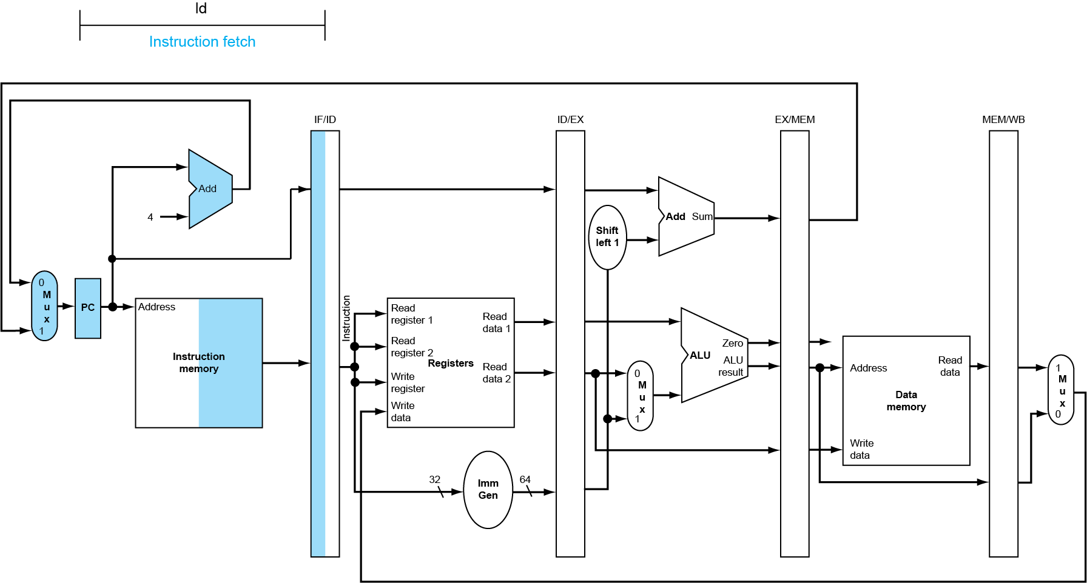
IF for Load, Store, …
Chapter 4 — The Processor — <number>
Notes:
Morgan Kaufmann Publishers
Chapter 4 — The Processor

Slide 34
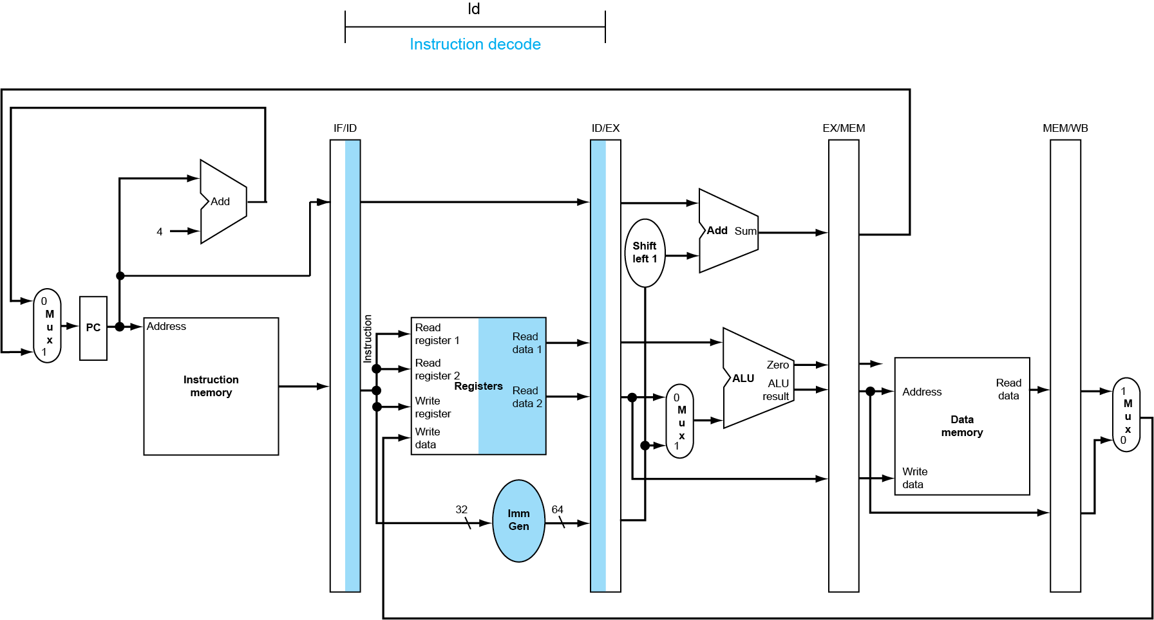
ID for Load, Store, …
Chapter 4 — The Processor — <number>
Notes:
Morgan Kaufmann Publishers
Chapter 4 — The Processor

Slide 35
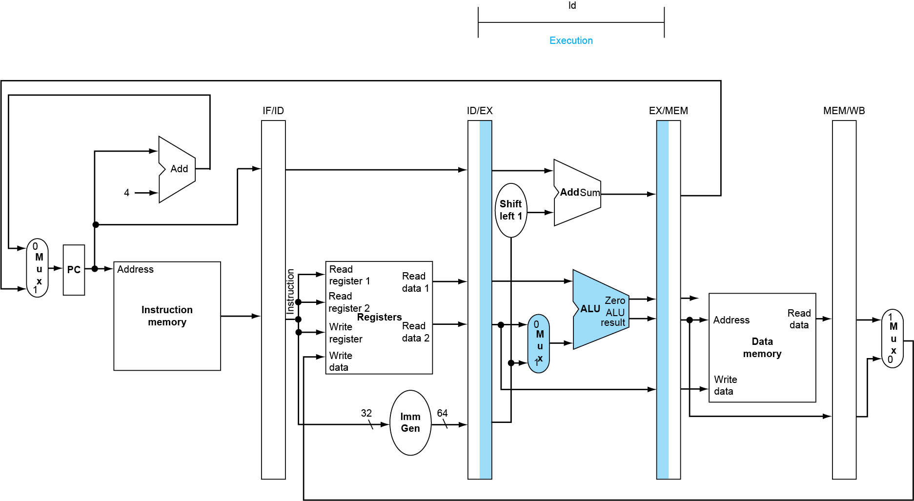
EX for Load
Chapter 4 — The Processor — <number>
Notes:
Morgan Kaufmann Publishers
Chapter 4 — The Processor

Slide 36
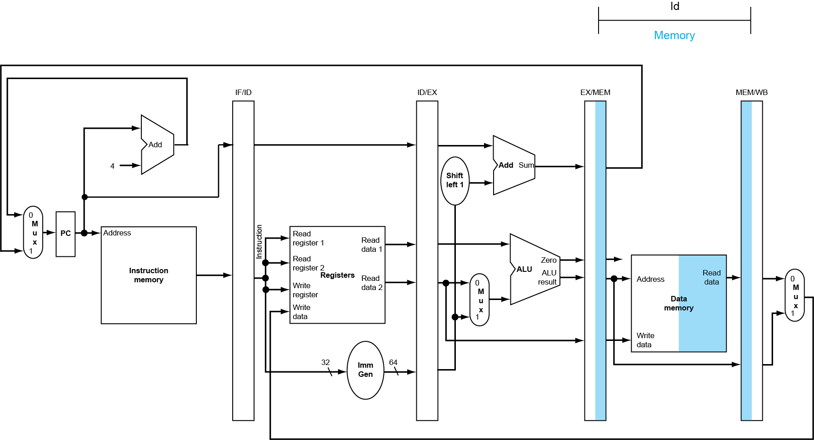
MEM for Load
Chapter 4 — The Processor — <number>
Notes:
Morgan Kaufmann Publishers
Chapter 4 — The Processor

Slide 37
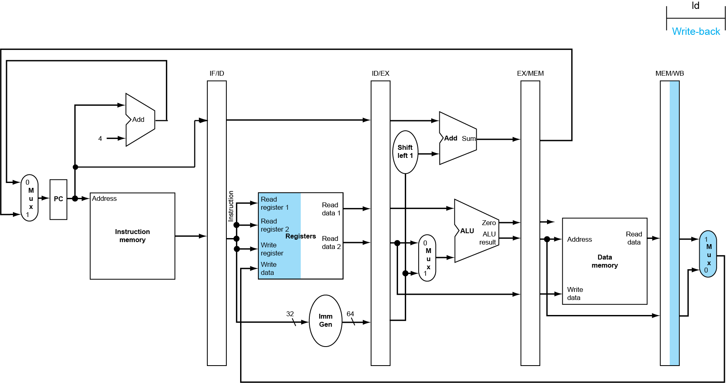
WB for Load
Wrong
register
number
Chapter 4 — The Processor — <number>
Notes:
Morgan Kaufmann Publishers
Chapter 4 — The Processor

Slide 38
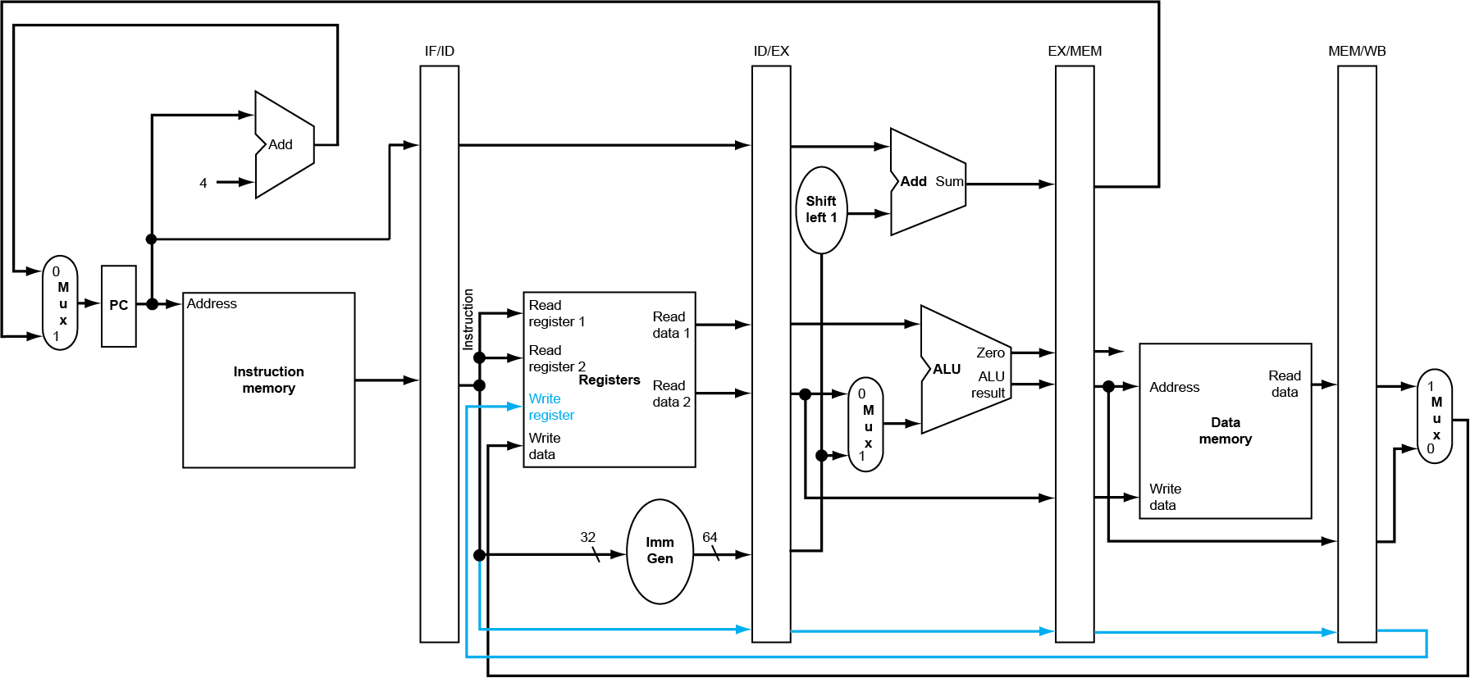
Corrected Datapath for Load
Chapter 4 — The Processor — <number>
Notes:
Morgan Kaufmann Publishers
Chapter 4 — The Processor

Slide 39
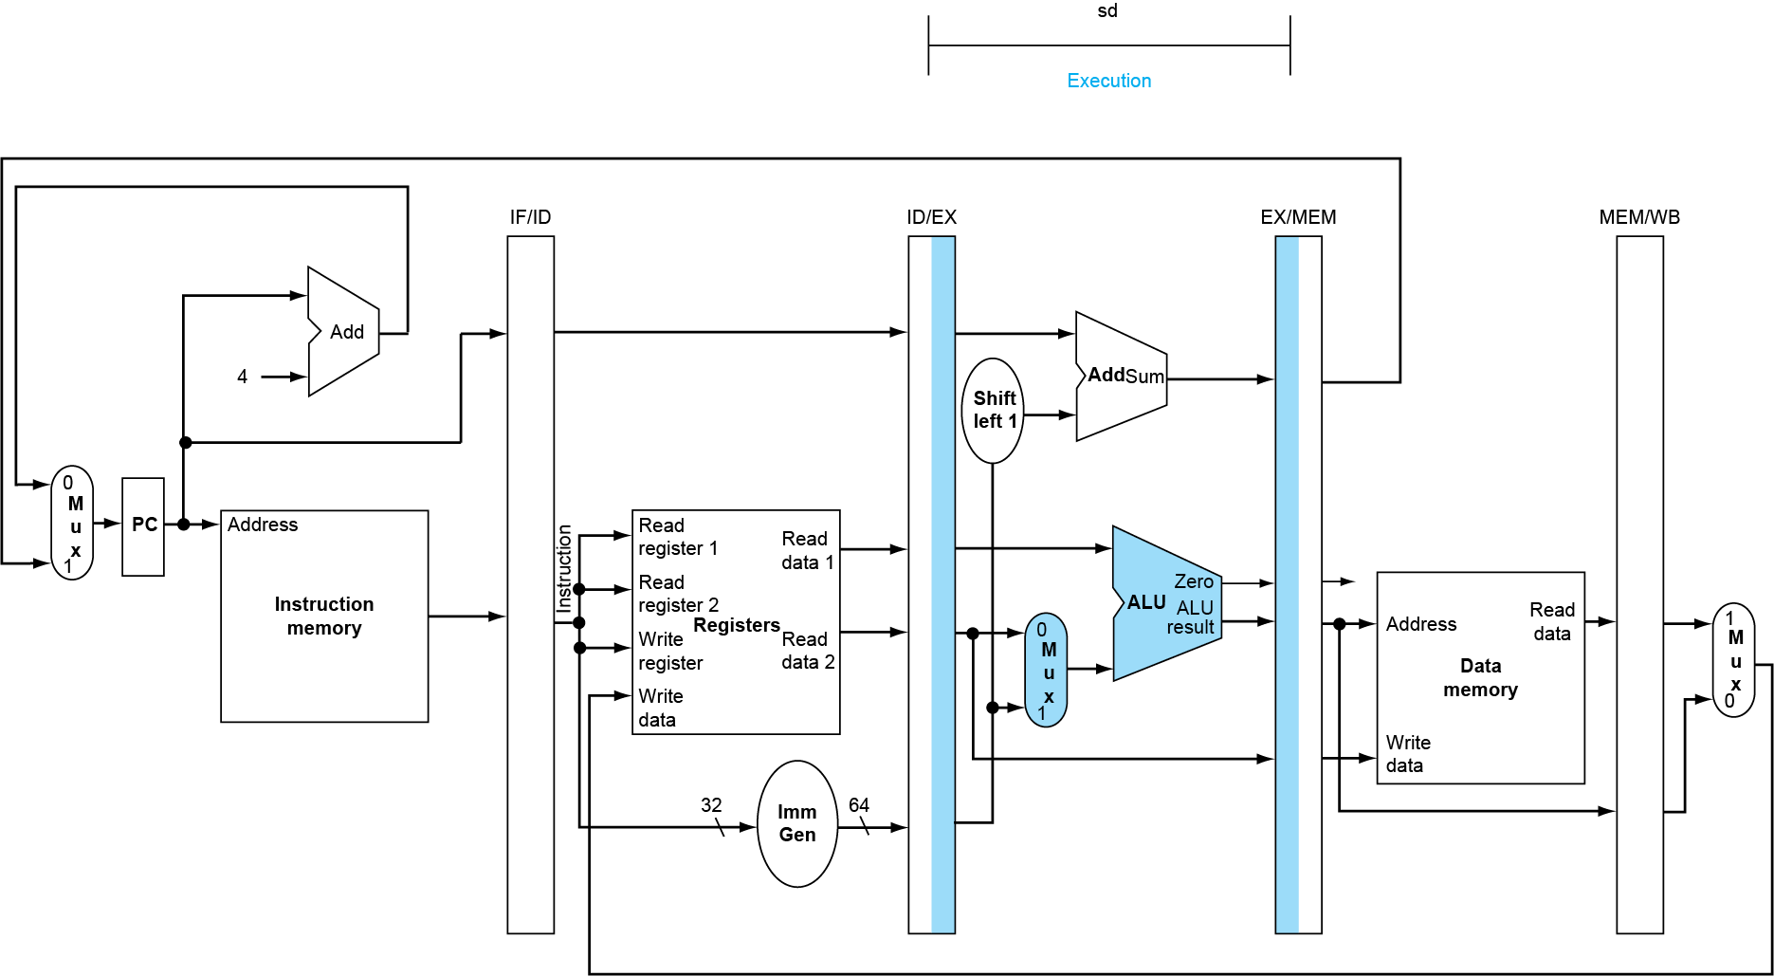
EX for Store
Chapter 4 — The Processor — <number>
Notes:
Morgan Kaufmann Publishers
Chapter 4 — The Processor

Slide 40
MEM for Store
Chapter 4 — The Processor — <number>
Notes:
Morgan Kaufmann Publishers
Chapter 4 — The Processor

Slide 41
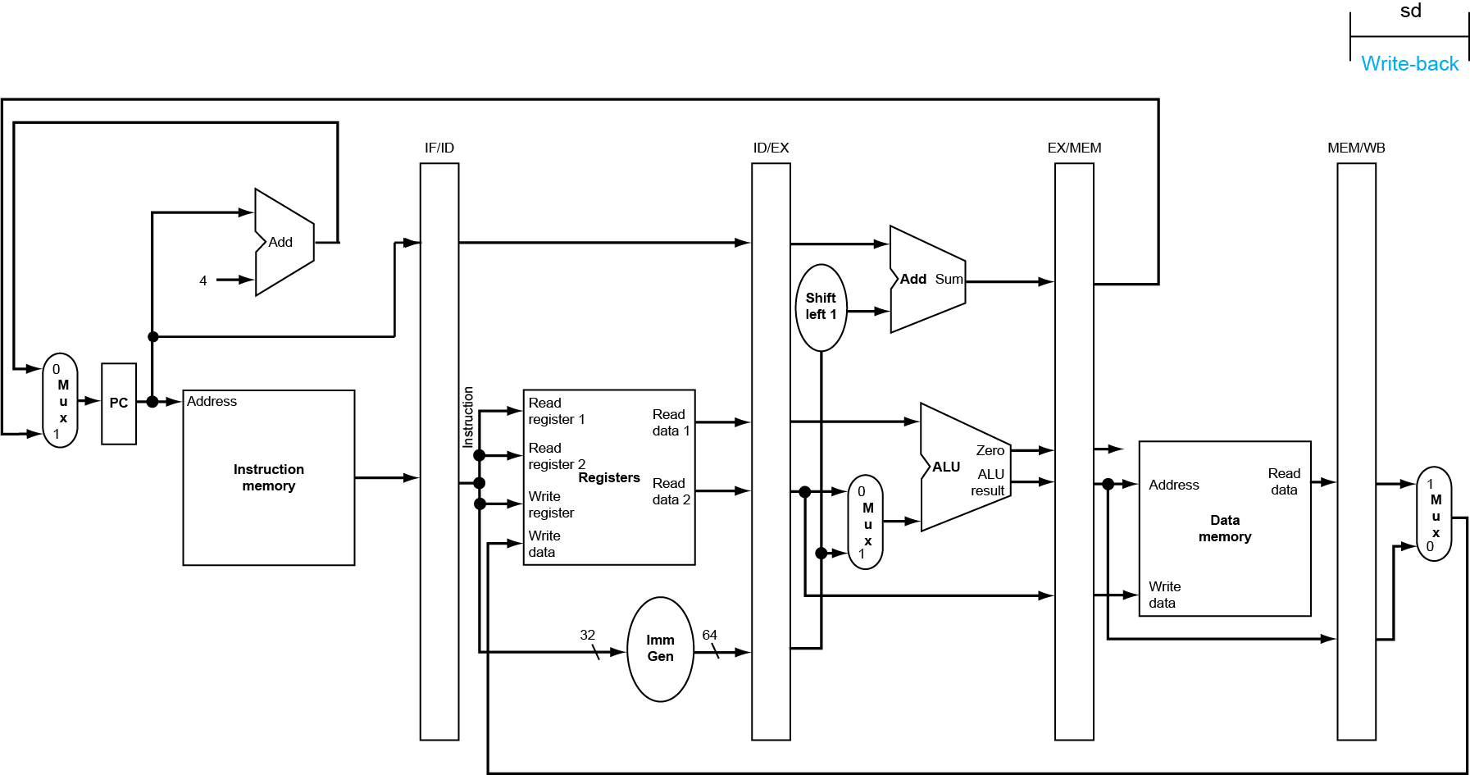
WB for Store
Chapter 4 — The Processor — <number>
Notes:
Morgan Kaufmann Publishers
Chapter 4 — The Processor

Slide 42
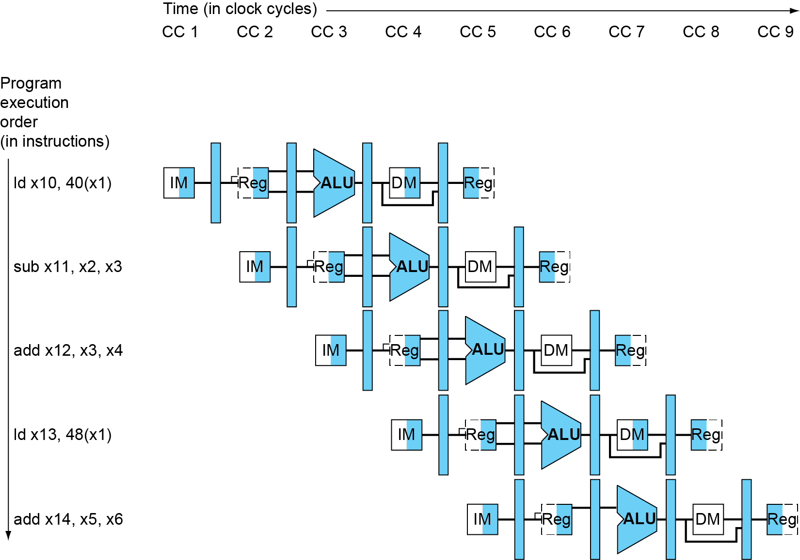
Multi-Cycle Pipeline Diagram
Form showing resource usage
Chapter 4 — The Processor — <number>
Notes:
Morgan Kaufmann Publishers
Chapter 4 — The Processor

Slide 43
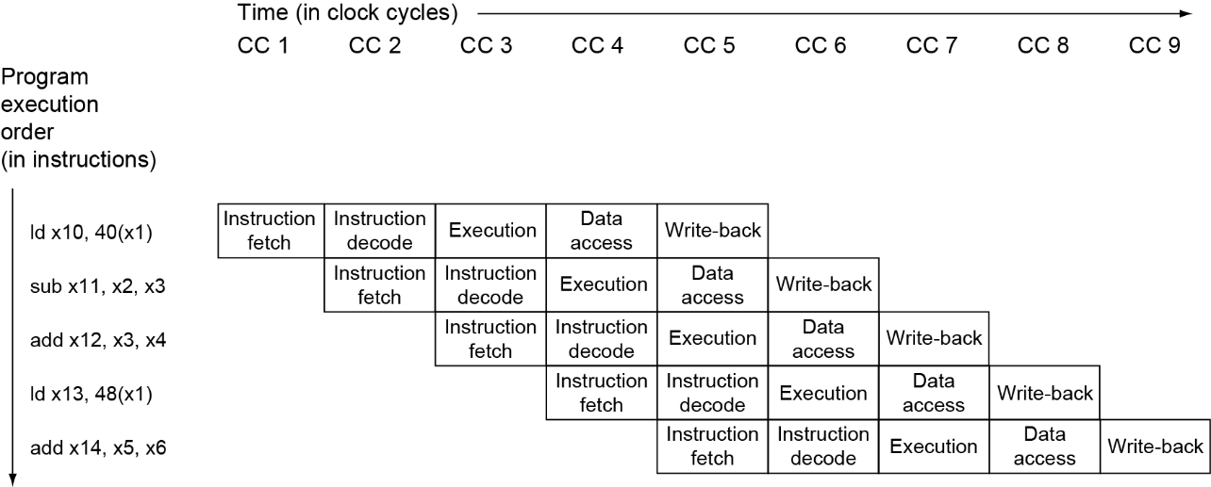
Multi-Cycle Pipeline Diagram
Traditional form
Chapter 4 — The Processor — <number>
Notes:
Morgan Kaufmann Publishers
Chapter 4 — The Processor

Slide 44
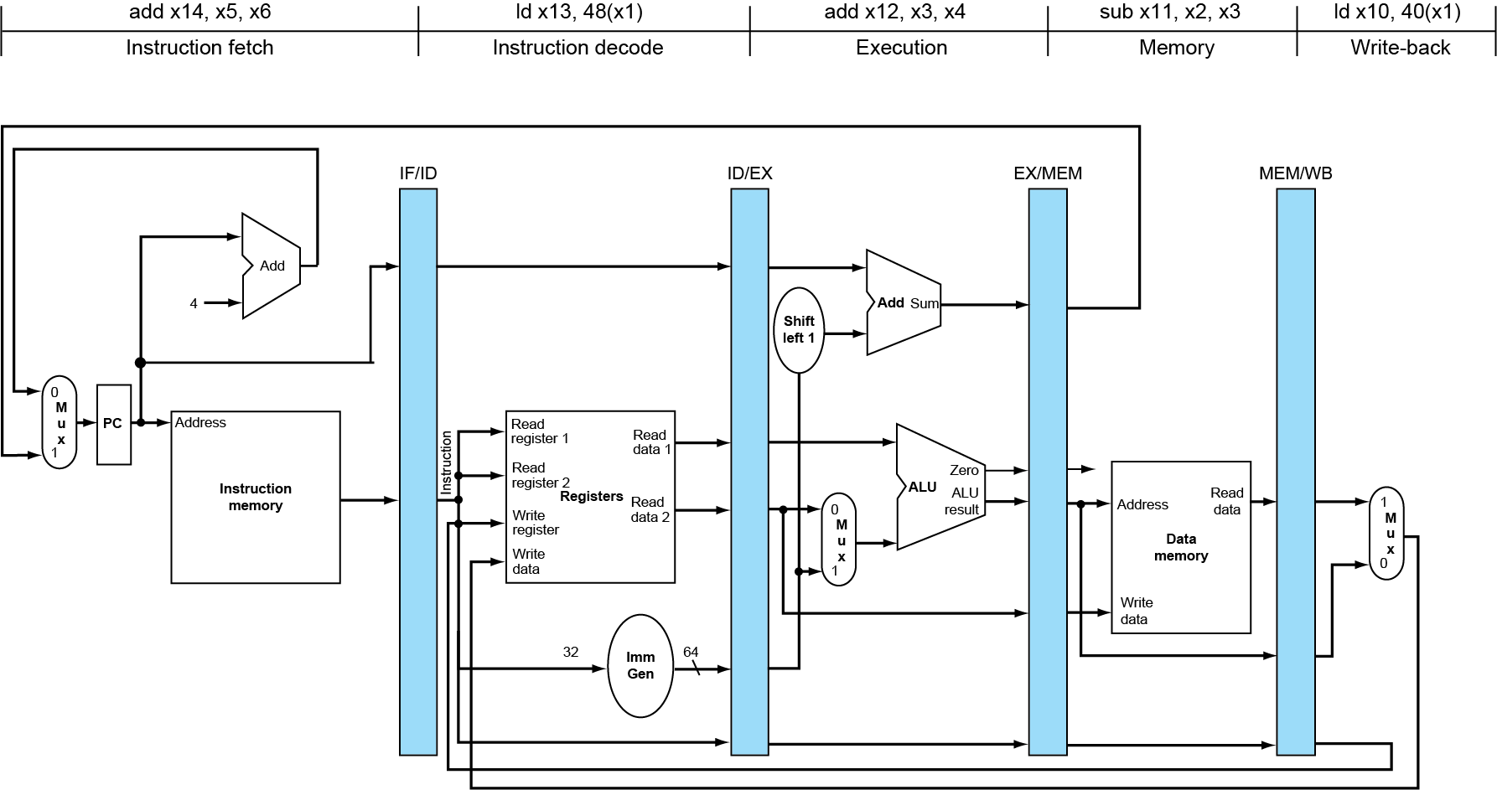
Single-Cycle Pipeline Diagram
State of pipeline in a given cycle
Chapter 4 — The Processor — <number>
Notes:
Morgan Kaufmann Publishers
Chapter 4 — The Processor

Slide 45
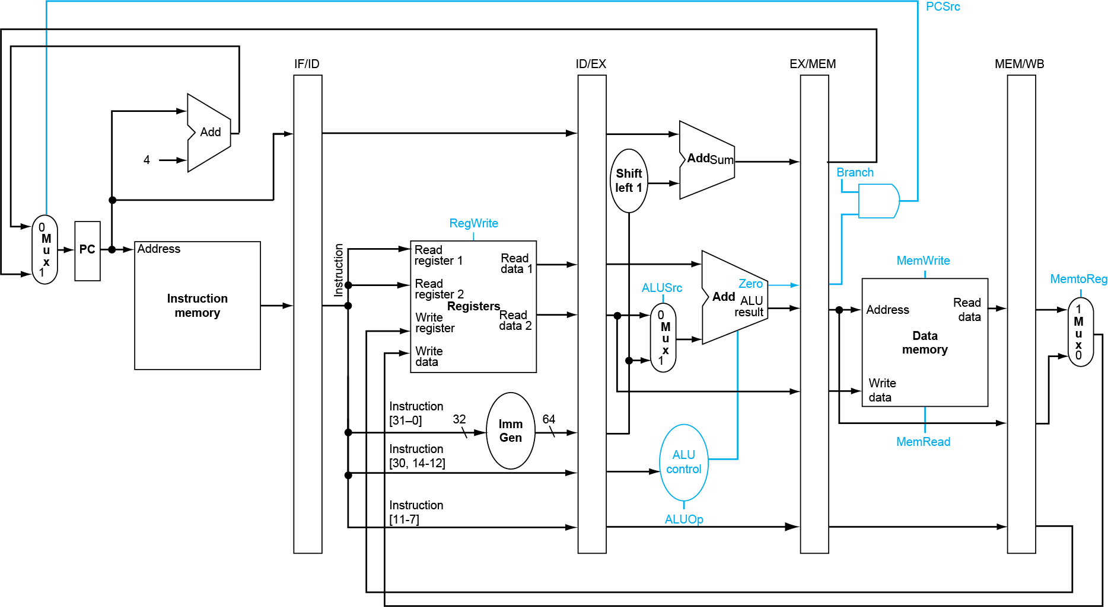
Pipelined Control (Simplified)
Chapter 4 — The Processor — <number>
Notes:
Morgan Kaufmann Publishers
Chapter 4 — The Processor

Slide 46
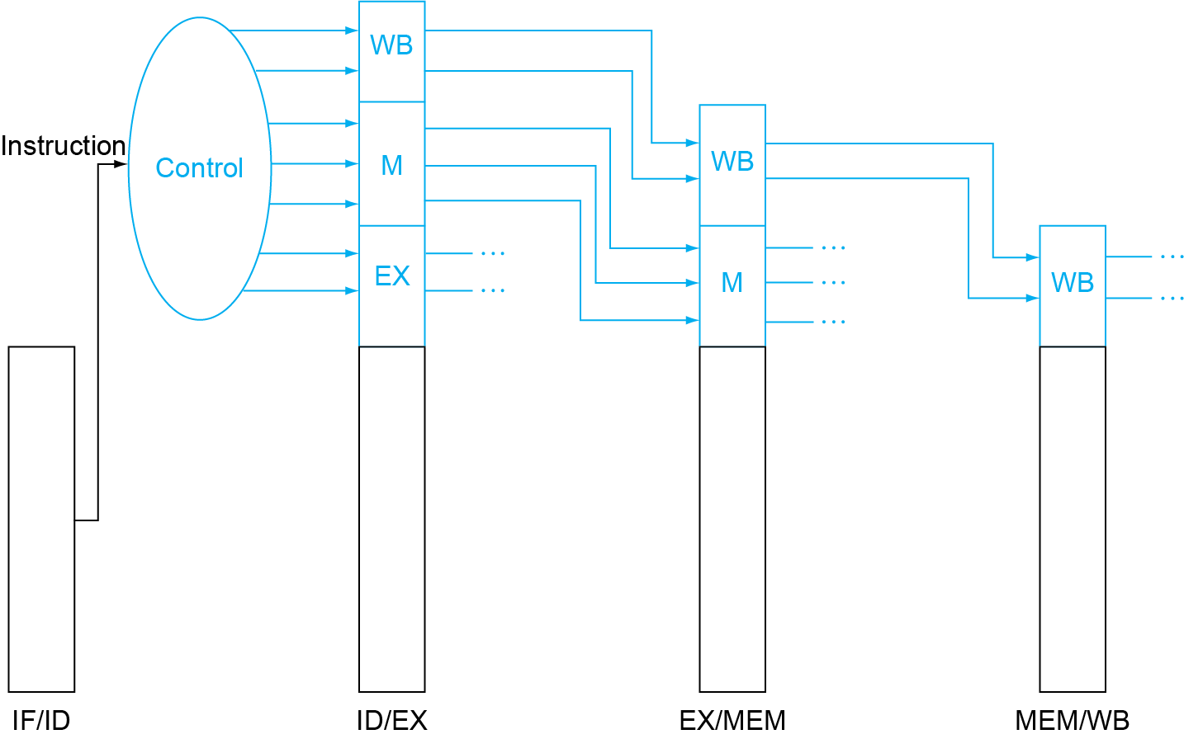
Pipelined Control
Control signals derived from instruction
  As in single-cycle implementation
Chapter 4 — The Processor — <number>
Notes:
Morgan Kaufmann Publishers
Chapter 4 — The Processor

Slide 47
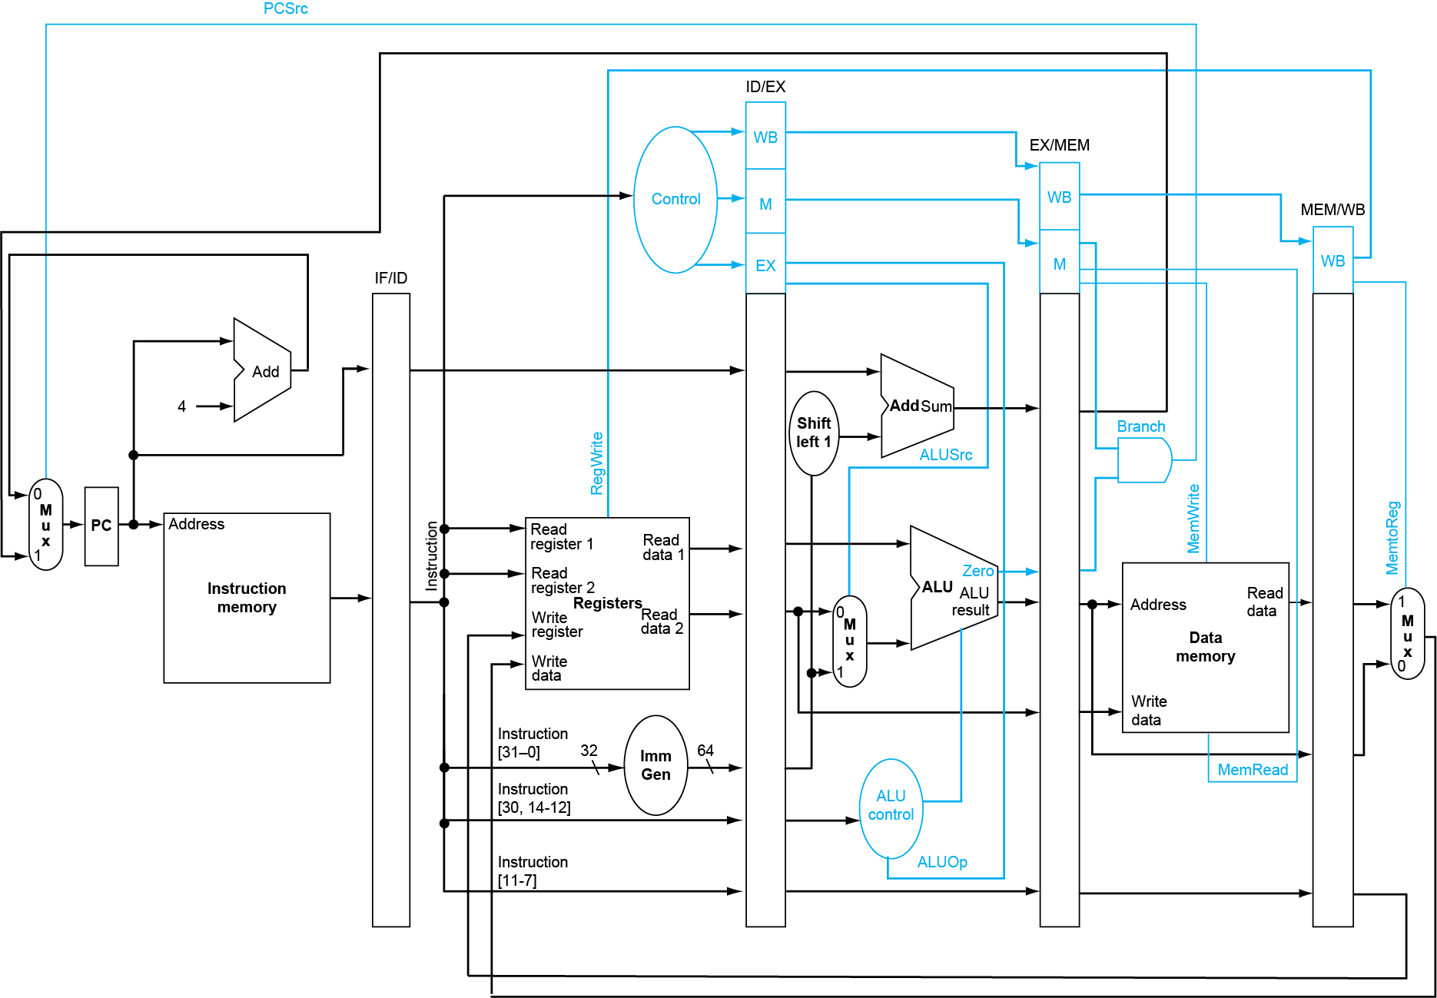
Pipelined Control
Chapter 4 — The Processor — <number>
Notes:
Morgan Kaufmann Publishers
Chapter 4 — The Processor

Slide 48
Data Hazards in ALU Instructions
Consider this sequence:
  sub x2, x1,x3
  and x12,x2,x5
  or x13,x6,x2
  add x14,x2,x2
  sd x15,100(x2)
We can resolve hazards with forwarding
  How do we detect when to forward?
§4.8 Data Hazards: Forwarding vs. Stalling
Chapter 4 — The Processor — <number>
Notes:
Morgan Kaufmann Publishers
Chapter 4 — The Processor

Slide 49
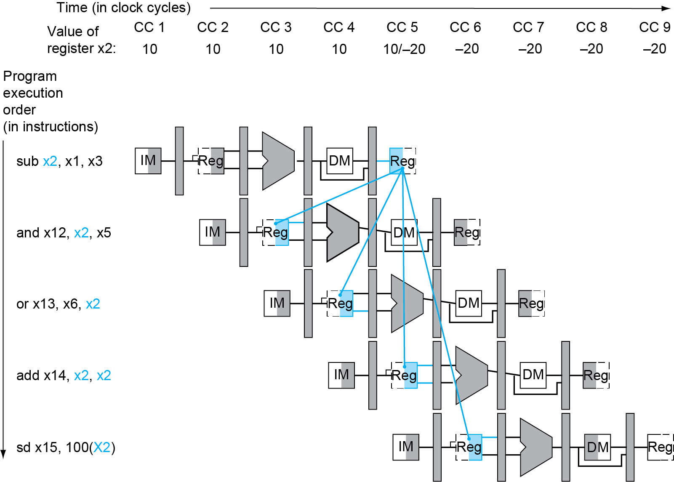
Dependencies & Forwarding
Chapter 4 — The Processor — <number>
Notes:
Morgan Kaufmann Publishers
Chapter 4 — The Processor

Slide 50
Detecting the Need to Forward
Pass register numbers along pipeline
  e.g., ID/EX.RegisterRs1 = register number for Rs1 sitting in ID/EX pipeline register
ALU operand register numbers in EX stage are given by
  ID/EX.RegisterRs1, ID/EX.RegisterRs2
Data hazards when
  1a. EX/MEM.RegisterRd = ID/EX.RegisterRs1
  1b. EX/MEM.RegisterRd = ID/EX.RegisterRs2
  2a. MEM/WB.RegisterRd = ID/EX.RegisterRs1
  2b. MEM/WB.RegisterRd = ID/EX.RegisterRs2
Fwd from
EX/MEM
pipeline reg
Fwd from
MEM/WB
pipeline reg
Chapter 4 — The Processor — <number>
Notes:
Morgan Kaufmann Publishers
Chapter 4 — The Processor

Slide 51
Detecting the Need to Forward
But only if forwarding instruction will write to a register!
  EX/MEM.RegWrite, MEM/WB.RegWrite
And only if Rd for that instruction is not x0
  EX/MEM.RegisterRd ≠ 0,
  MEM/WB.RegisterRd ≠ 0
Chapter 4 — The Processor — <number>
Notes:
Morgan Kaufmann Publishers
Chapter 4 — The Processor

Slide 52
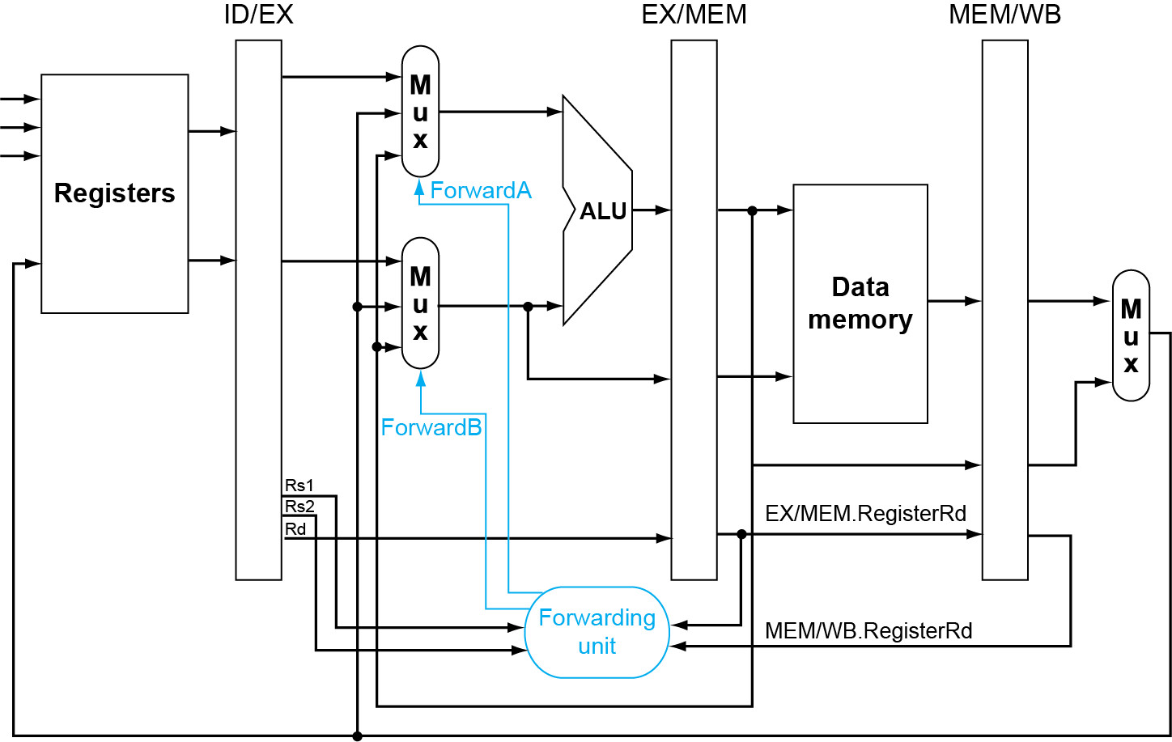
Forwarding Paths
Chapter 4 — The Processor — <number>
Notes:
Morgan Kaufmann Publishers
Chapter 4 — The Processor

Slide 53
Forwarding Conditions
Mux control | Source | Explanation
ForwardA = 00 | ID/EX | The first ALU operand comes from the register file.
ForwardA = 10 | EX/MEM | The first ALU operand is forwarded from the prior ALU result.
ForwardA = 01 | MEM/WB | The first ALU operand is forwarded from data memory or an earlier ALU result.
ForwardB = 00 | ID/EX | The second ALU operand comes from the register file.
ForwardB = 10 | EX/MEM | The second ALU operand is forwarded from the prior ALU result.
ForwardB = 01 | MEM/WB | The second ALU operand is forwarded from data memory or an earlier ALU result.
Chapter 4 — The Processor — <number>
Notes:
Morgan Kaufmann Publishers
Chapter 4 — The Processor

Slide 54
Double Data Hazard
Consider the sequence:
  add x1,x1,x2
  add x1,x1,x3
  add x1,x1,x4
Both hazards occur
  Want to use the most recent
Revise MEM hazard condition
  Only fwd if EX hazard condition isn’t true
Chapter 4 — The Processor — <number>
Notes:
Morgan Kaufmann Publishers
Chapter 4 — The Processor

Slide 55
Revised Forwarding Condition
MEM hazard
  if (MEM/WB.RegWrite
  and (MEM/WB.RegisterRd ≠ 0)
  and not(EX/MEM.RegWrite and (EX/MEM.RegisterRd ≠ 0)
  and (EX/MEM.RegisterRd ≠ ID/EX.RegisterRs1))
  and (MEM/WB.RegisterRd = ID/EX.RegisterRs1)) ForwardA = 01
  if (MEM/WB.RegWrite
  and (MEM/WB.RegisterRd ≠ 0)
  and not(EX/MEM.RegWrite and (EX/MEM.RegisterRd ≠ 0)
  and (EX/MEM.RegisterRd ≠ ID/EX.RegisterRs2))
  and (MEM/WB.RegisterRd = ID/EX.RegisterRs2)) ForwardB = 01
Chapter 4 — The Processor — <number>
Notes:
Morgan Kaufmann Publishers
Chapter 4 — The Processor

Slide 56
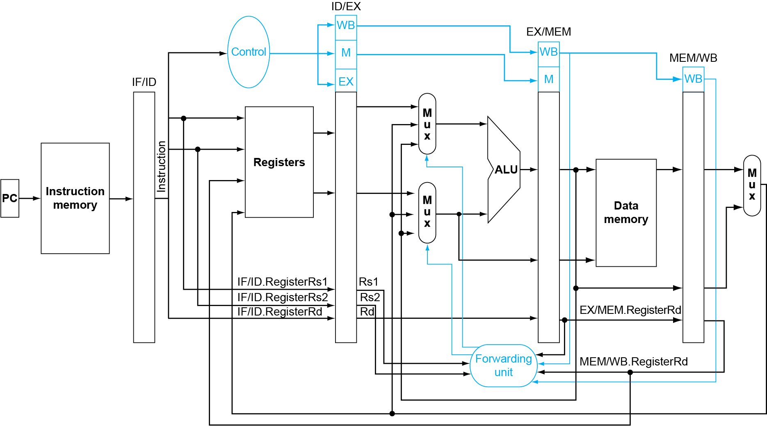
Datapath with Forwarding
Chapter 4 — The Processor — <number>
Notes:
Morgan Kaufmann Publishers
Chapter 4 — The Processor

Slide 57
Load-Use Hazard Detection
Check when using instruction is decoded in ID stage
an instruction tries to read a register following a load instruction that writes the same register
ALU operand register numbers in ID stage are given by
  IF/ID.RegisterRs1, IF/ID.RegisterRs2
Load-use hazard when
  ID/EX.MemRead and
  ((ID/EX.RegisterRd = IF/ID.RegisterRs1) or
  (ID/EX.RegisterRd = IF/ID.RegisterRs1))
If detected, stall and insert bubble
Chapter 4 — The Processor — <number>
Notes:
Morgan Kaufmann Publishers
Chapter 4 — The Processor

Slide 58
How to Stall the Pipeline
Force control values in ID/EX register
to 0
  EX, MEM and WB do nop (no-operation)
Prevent update of PC and IF/ID register
  Using instruction is decoded again
  Following instruction is fetched again
  1-cycle stall allows MEM to read data for ld
    Can subsequently forward to EX stage
Chapter 4 — The Processor — <number>
Notes:
Morgan Kaufmann Publishers
Chapter 4 — The Processor

Slide 59
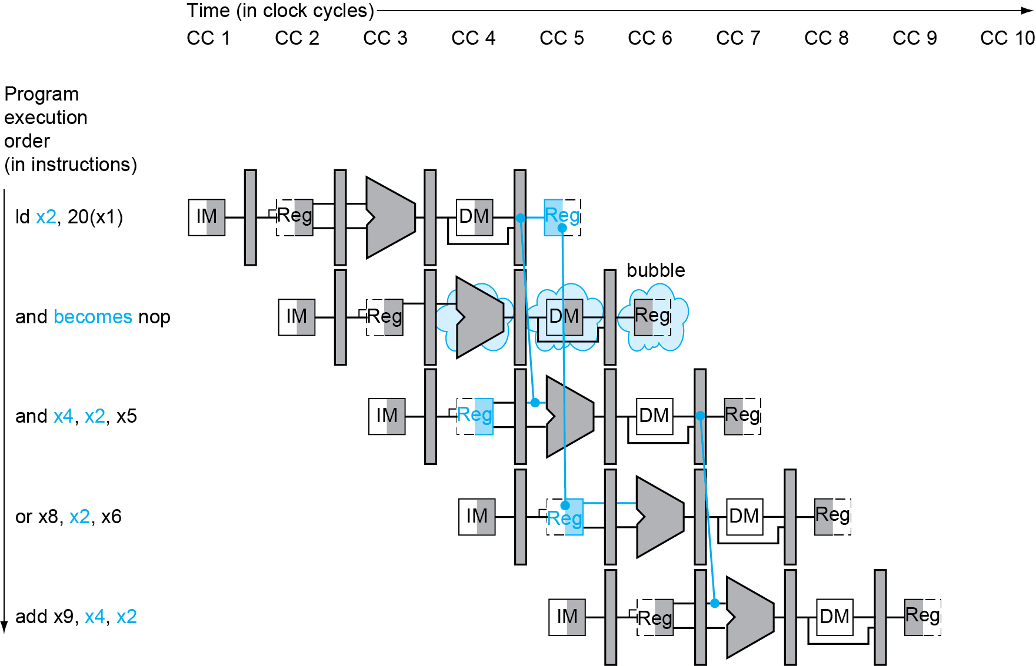
Load-Use Data Hazard
Stall inserted here
Chapter 4 — The Processor — <number>
Notes:
Morgan Kaufmann Publishers
Chapter 4 — The Processor

Slide 60
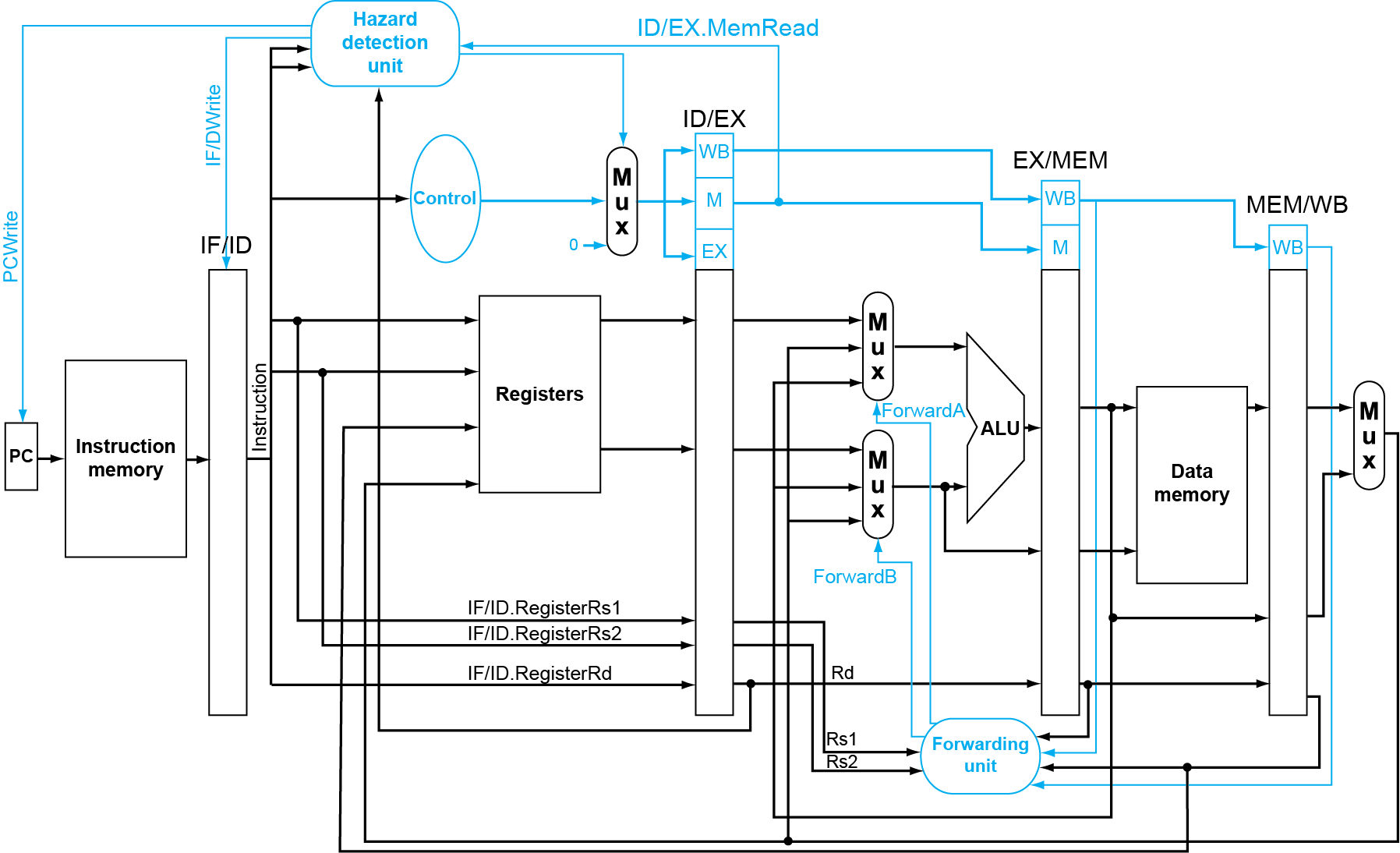
Datapath with Hazard Detection
Chapter 4 — The Processor — <number>
Notes:
Morgan Kaufmann Publishers
Chapter 4 — The Processor

Slide 61
Stalls and Performance
The BIG Picture
Stalls reduce performance
  But are required to get correct results
Compiler can arrange code to avoid hazards and stalls
  Requires knowledge of the pipeline structure
Chapter 4 — The Processor — <number>
Notes:
Morgan Kaufmann Publishers
Chapter 4 — The Processor

Slide 62
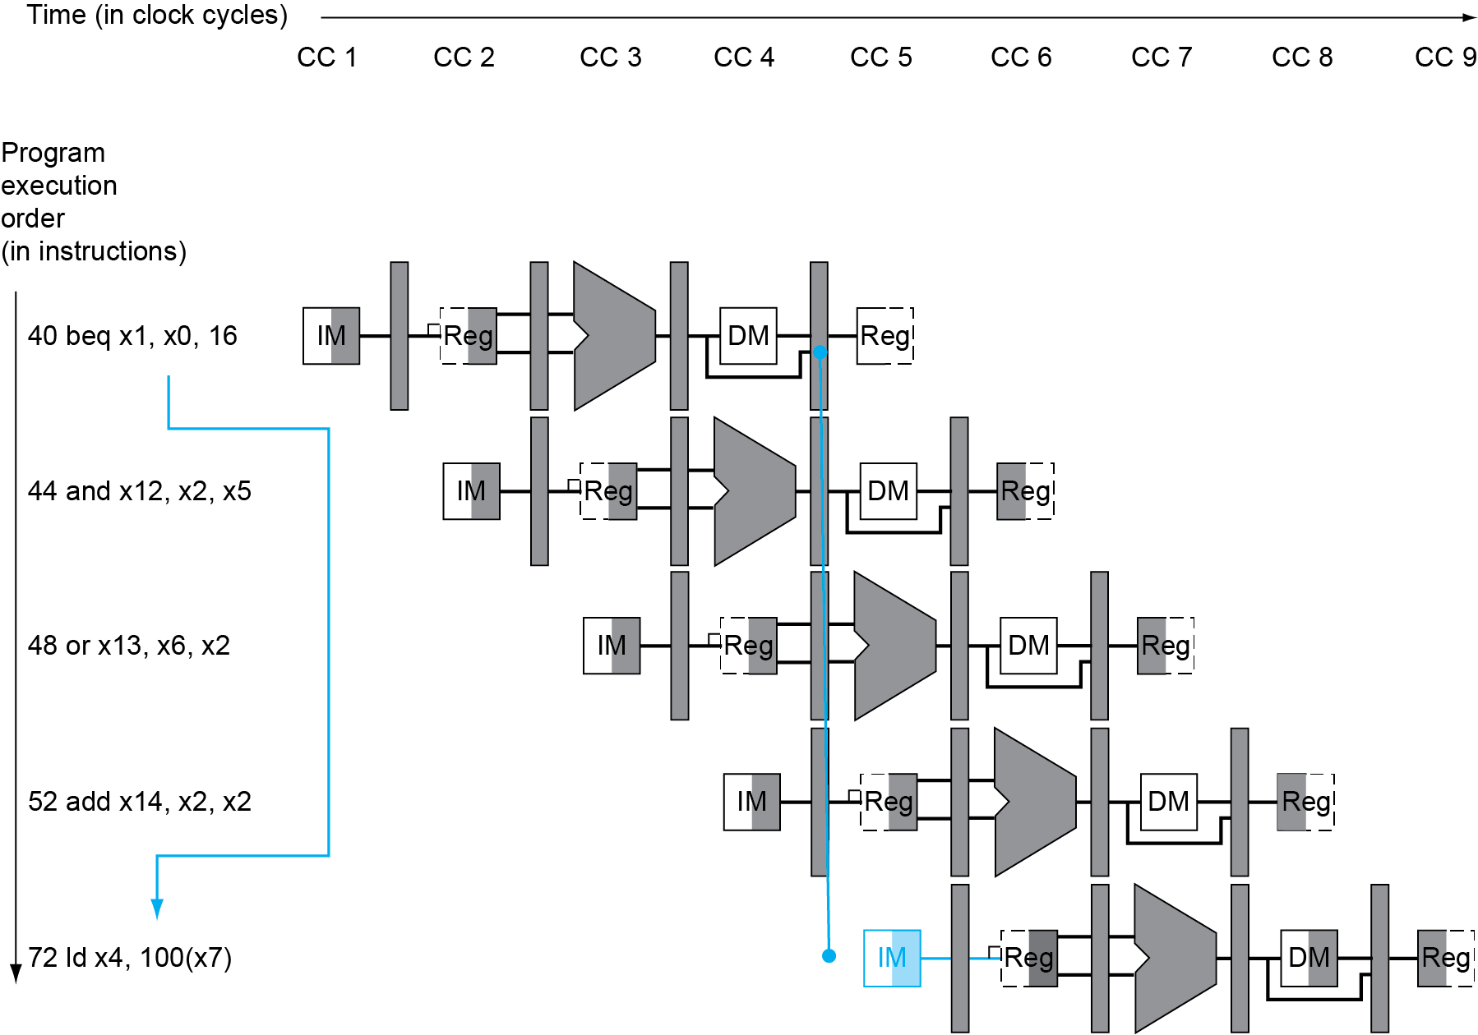
Branch Hazards
§4.9 Control Hazards
If branch outcome determined in MEM
Flush these
instructions
(Set control
values to 0)
PC
Chapter 4 — The Processor — <number>
Notes:
Morgan Kaufmann Publishers
Chapter 4 — The Processor

Slide 63
Reducing Branch Delay
Move hardware to determine outcome to ID stage
  Target address adder
  Register comparator
Example: branch taken
  36: sub x10, x4, x8
  40: beq x1, x3, 16 // PC-relative branch
  // to 40+16*2=72
  44: and x12, x2, x5
  48: orr x13, x2, x6
  52: add x14, x4, x2
  56: sub x15, x6, x7
  ...
  72: ld x4, 50(x7)
Chapter 4 — The Processor — <number>
Notes:
Morgan Kaufmann Publishers
Chapter 4 — The Processor

Slide 64
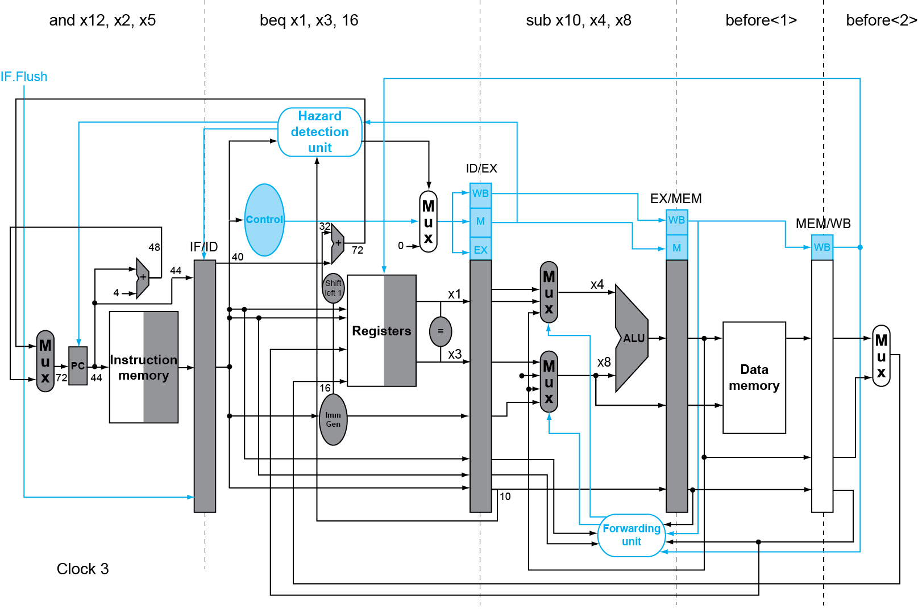
Example: Branch Taken
Chapter 4 — The Processor — <number>
Notes:
Morgan Kaufmann Publishers
Chapter 4 — The Processor

Slide 65
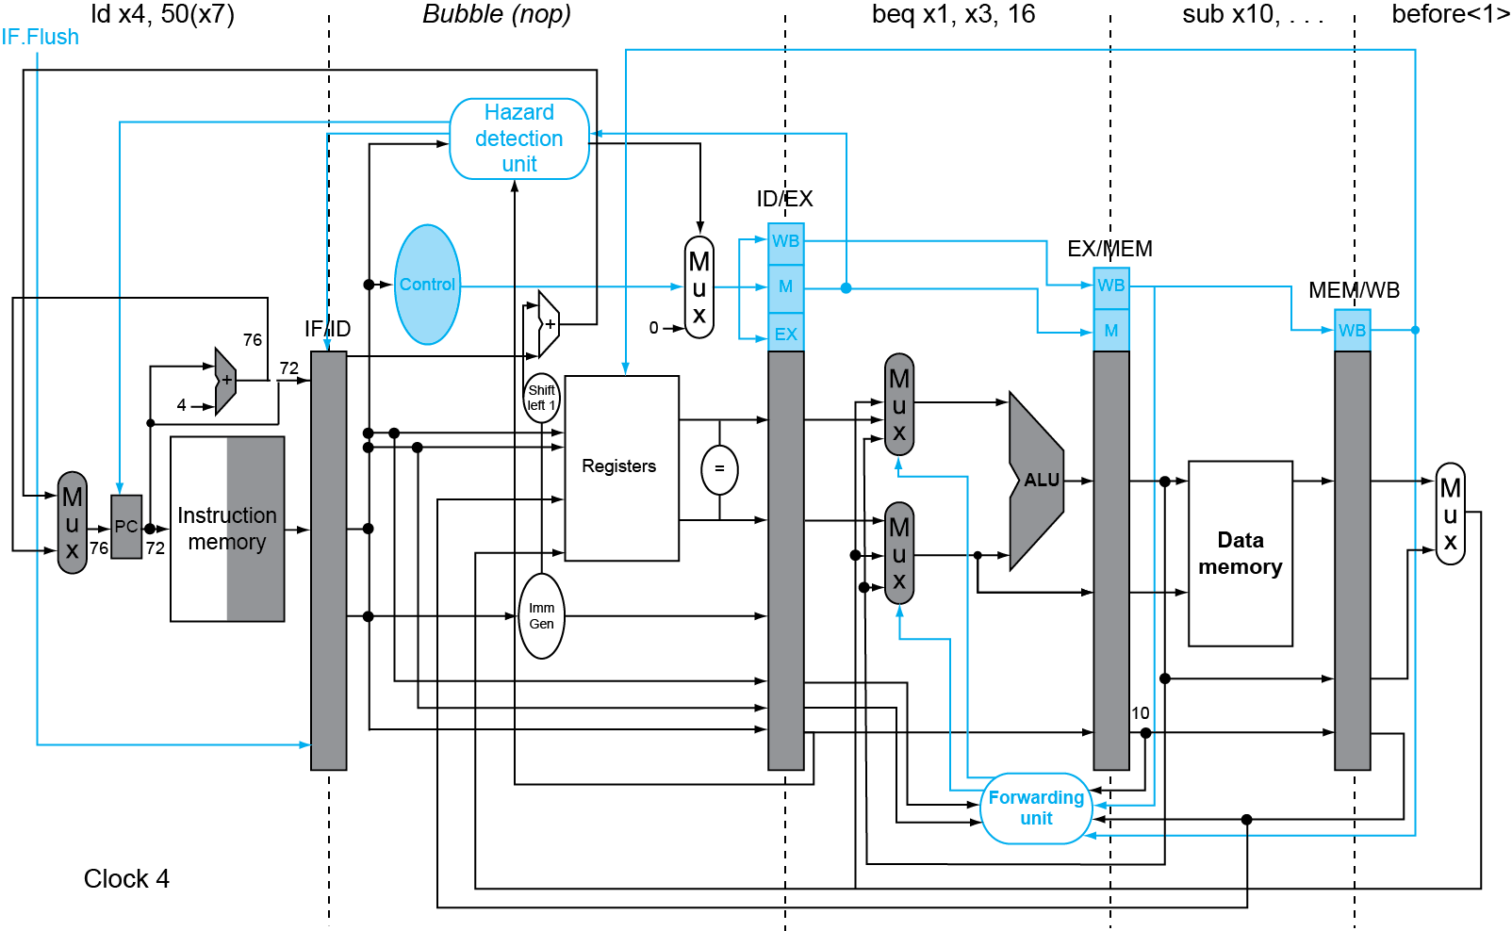
Example: Branch Taken
Chapter 4 — The Processor — <number>
Notes:
Morgan Kaufmann Publishers
Chapter 4 — The Processor

Slide 66
Data Hazards for Branches
If a comparison register is a destination of 2nd or 3rd preceding ALU instruction
add x1, x2, x3
IF
ID
EX
MEM
WB
add x4, x5, x6
IF
ID
EX
MEM
WB
…
IF
ID
EX
MEM
WB
beq x1, x4, target
IF
ID
EX
MEM
WB
Can resolve using forwarding
Chapter 4 — The Processor — <number>
Notes:
Morgan Kaufmann Publishers
Chapter 4 — The Processor

Slide 67
Data Hazards for Branches
If a comparison register is a destination of preceding ALU instruction or 2nd preceding load instruction
  Need 1 stall cycle
lw x1, addr
IF
ID
EX
MEM
WB
add x4, $x5, $x6
IF
ID
EX
MEM
WB
beq stalled
IF
ID
beq x1, x4, target
ID
EX
MEM
WB
Chapter 4 — The Processor — <number>
Notes:
Morgan Kaufmann Publishers
Chapter 4 — The Processor

Slide 68
Data Hazards for Branches
If a comparison register is a destination of immediately preceding load instruction
  Need 2 stall cycles
lw x1, addr
IF
ID
EX
MEM
WB
beq stalled
IF
ID
beq stalled
ID
beq x1, x0, target
ID
EX
MEM
WB
Chapter 4 — The Processor — <number>
Notes:
Morgan Kaufmann Publishers
Chapter 4 — The Processor

Slide 69
Dynamic Branch Prediction
In deeper and superscalar pipelines, branch penalty is more significant
Use dynamic prediction
  Branch prediction buffer (aka branch history table)
  Indexed by recent branch instruction addresses
  Stores outcome (taken/not taken)
  To execute a branch
    Check table, expect the same outcome
    Start fetching from fall-through or target
    If wrong, flush pipeline and flip prediction
Chapter 4 — The Processor — <number>
Notes:
Morgan Kaufmann Publishers
Chapter 4 — The Processor

Slide 70
1-Bit Predictor: Shortcoming
Inner loop branches mispredicted twice!
outer: …
…
inner: …
…
beq …, …, inner
…
beq …, …, outer
  Mispredict as taken on last iteration of inner loop
  Then mispredict as not taken on first iteration of inner loop next time around
Chapter 4 — The Processor — <number>
Notes:
Morgan Kaufmann Publishers
Chapter 4 — The Processor

Slide 71
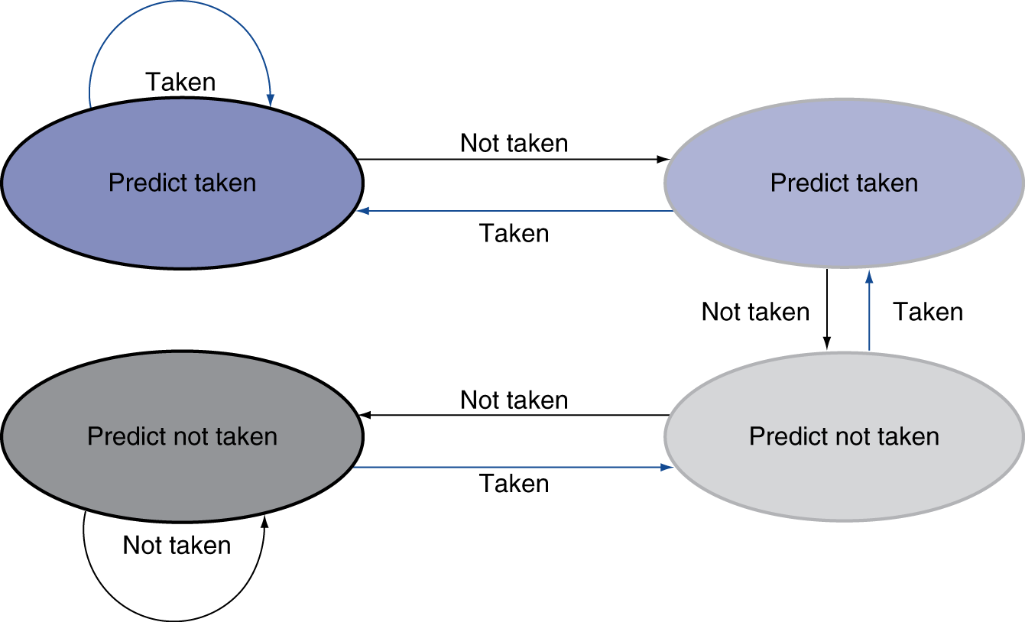
2-Bit Predictor
Only change prediction on two successive mispredictions
Strongly Taken (มั่นใจมากว่ากระโดด)
Weakly Taken (คาดเดาว่ากระโดดแต่ไม่มั่นใจ)
Weakly Not Taken (คาดเดาว่าไม่กระโดดแต่ไม่มั่นใจ)
Strongly Not Taken (มั่นใจมากว่าไม่กระโดด)
Chapter 4 — The Processor — <number>
Notes:
Morgan Kaufmann Publishers
Chapter 4 — The Processor

Slide 72
Calculating the Branch Target
Even with predictor, still need to calculate the target address
  1-cycle penalty for a taken branch
Branch target buffer
  Cache of target addresses
  Indexed by PC when instruction fetched
    If hit and instruction is branch predicted taken, can fetch target immediately
Chapter 4 — The Processor — <number>
Notes:
Morgan Kaufmann Publishers
Chapter 4 — The Processor

Slide 73
Exceptions and Interrupts
§4.10 Exceptions
“Unexpected” events requiring change
in flow of control
  Different ISAs use the terms differently
Exception
  Arises within the CPU
    e.g., undefined opcode, syscall, …
Interrupt
  From an external I/O controller
Dealing with them without sacrificing performance is hard
Chapter 4 — The Processor — <number>
Notes:
Morgan Kaufmann Publishers
Chapter 4 — The Processor
Sacrificing สังเวย

Slide 74
Handling Exceptions
Save PC of offending (or interrupted) instruction
  In RISC-V: Supervisor Exception Program Counter (SEPC)
Save indication of the problem
  In RISC-V: Supervisor Exception Cause Register (SCAUSE)
  64 bits, but most bits unused
    Exception code field: 2 for undefined opcode, 12 for hardware malfunction, …
Jump to handler
  Assume at 0000 0000 1C09 0000_{hex}
Chapter 4 — The Processor — <number>
Notes:
Morgan Kaufmann Publishers
Chapter 4 — The Processor

Slide 75
An Alternate Mechanism
Vectored Interrupts
  Handler address determined by the cause
Exception vector address to be added to a vector table base register:
  Undefined opcode 00 0100 0000_{two}
  Hardware malfunction: 01 1000 0000_{two}
  …: …
Instructions either
  Deal with the interrupt, or
  Jump to real handler
Chapter 4 — The Processor — <number>
Notes:
Morgan Kaufmann Publishers
Chapter 4 — The Processor

Slide 76
Handler Actions
Read cause, and transfer to relevant handler
Determine action required
If restartable
  Take corrective action
  use SEPC to return to program
Otherwise
  Terminate program
  Report error using SEPC, SCAUSE, …
Chapter 4 — The Processor — <number>
Notes:
Morgan Kaufmann Publishers
Chapter 4 — The Processor

Slide 77
Exceptions in a Pipeline
Another form of control hazard
Consider malfunction on add in EX stage
  add x1, x2, x1
  Prevent x1 from being clobbered
  Complete previous instructions
  Flush add and subsequent instructions
  Set SEPC and SCAUSE register values
  Transfer control to handler
Similar to mispredicted branch
  Use much of the same hardware
Chapter 4 — The Processor — <number>
Notes:
Morgan Kaufmann Publishers
Chapter 4 — The Processor

Slide 78
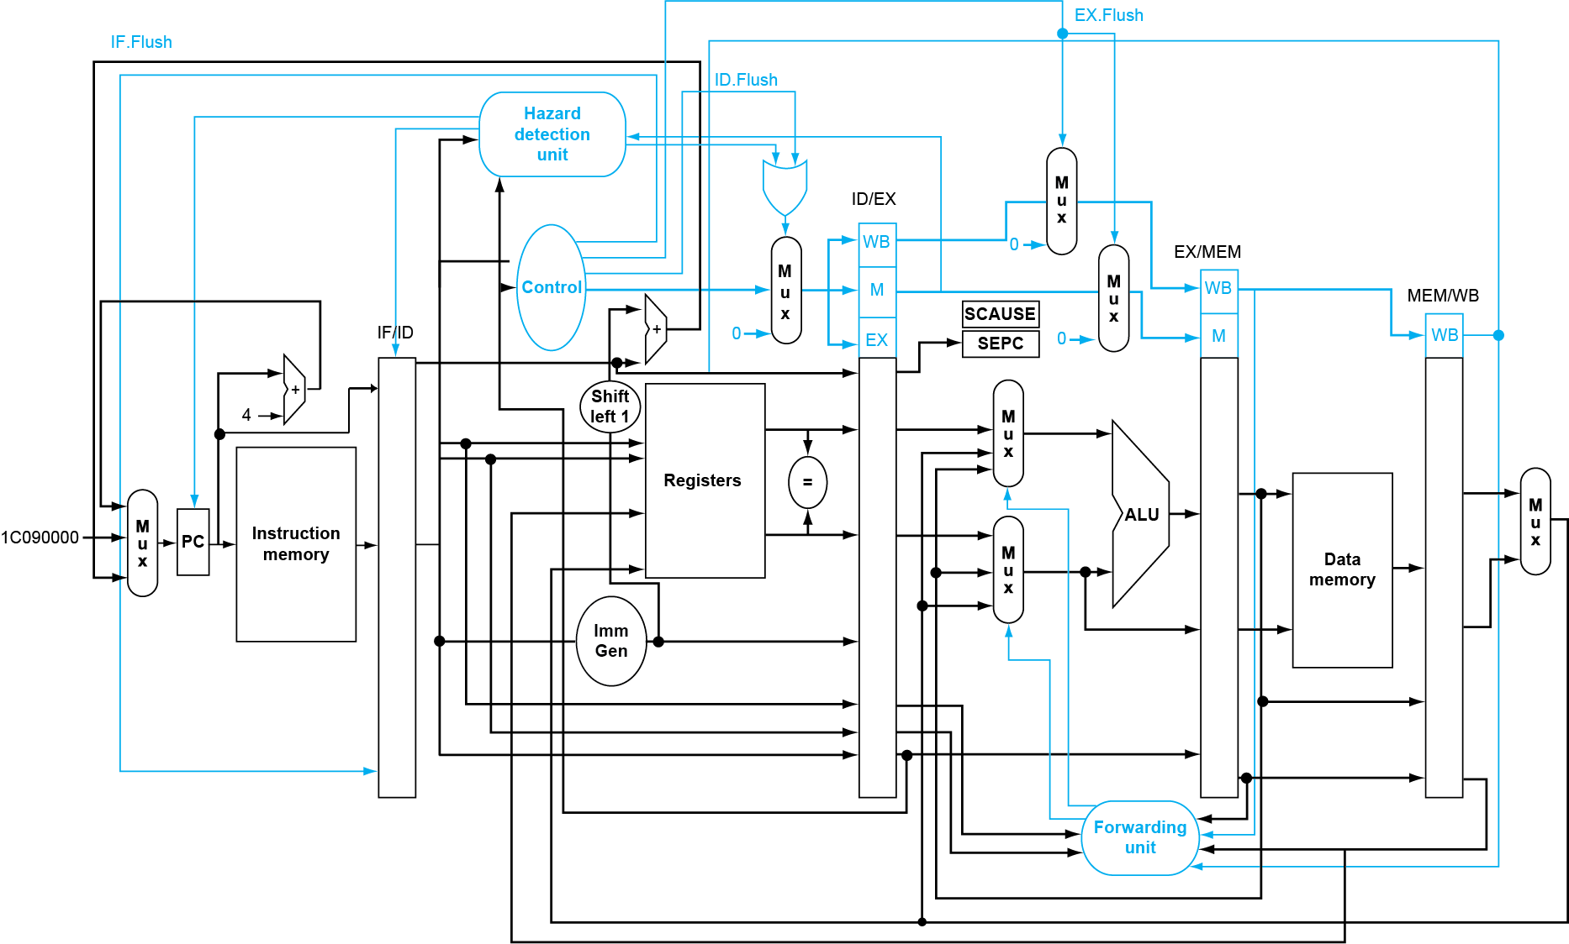
Pipeline with Exceptions
Chapter 4 — The Processor — <number>
Notes:
Morgan Kaufmann Publishers
Chapter 4 — The Processor

Slide 79
Exception Properties
Restartable exceptions
  Pipeline can flush the instruction
  Handler executes, then returns to the instruction
    Refetched and executed from scratch
PC saved in SEPC register
  Identifies causing instruction
Chapter 4 — The Processor — <number>
Notes:
Morgan Kaufmann Publishers
Chapter 4 — The Processor

Slide 80
Exception Example
Exception on add in
  40 sub x11, x2, x4
  44 and x12, x2, x5
  48 orr x13, x2, x6
  4c add x1, x2, x1
  50 sub x15, x6, x7
  54 ld x16, 100(x7)
  …
Handler
  1C090000 sd x26, 1000(x10)
  1c090004 sd x27, 1008(x10)
  …
Chapter 4 — The Processor — <number>
Notes:
Morgan Kaufmann Publishers
Chapter 4 — The Processor

Slide 81
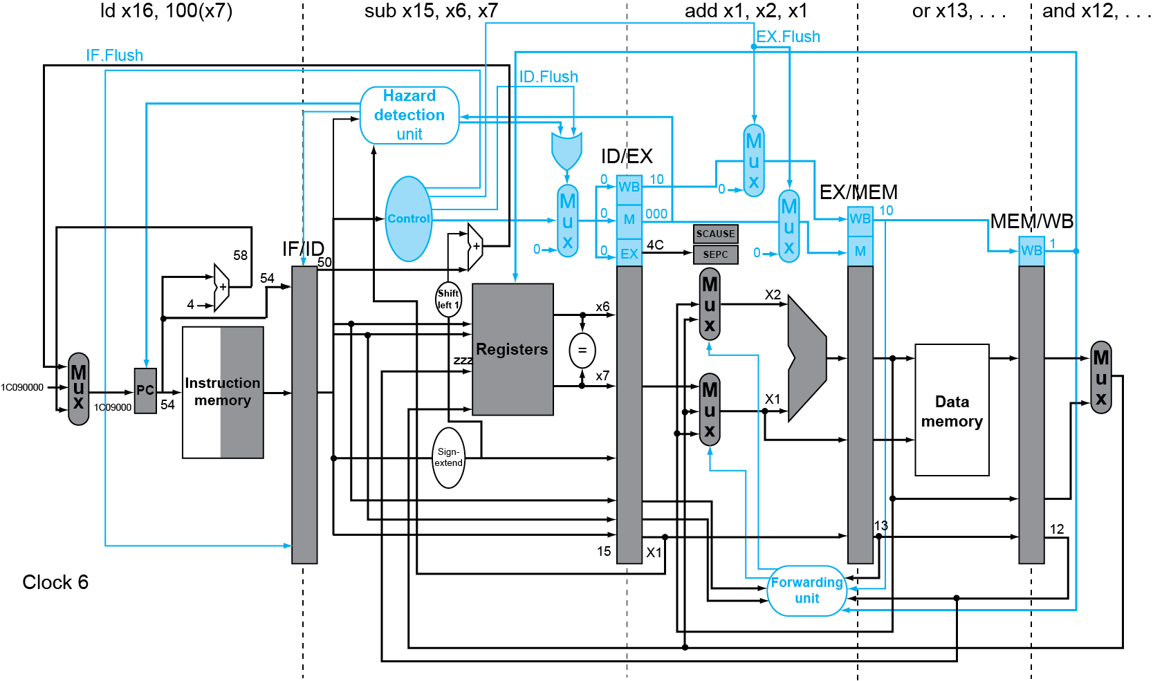
Exception Example
Chapter 4 — The Processor — <number>
Notes:
Morgan Kaufmann Publishers
Chapter 4 — The Processor

Slide 82
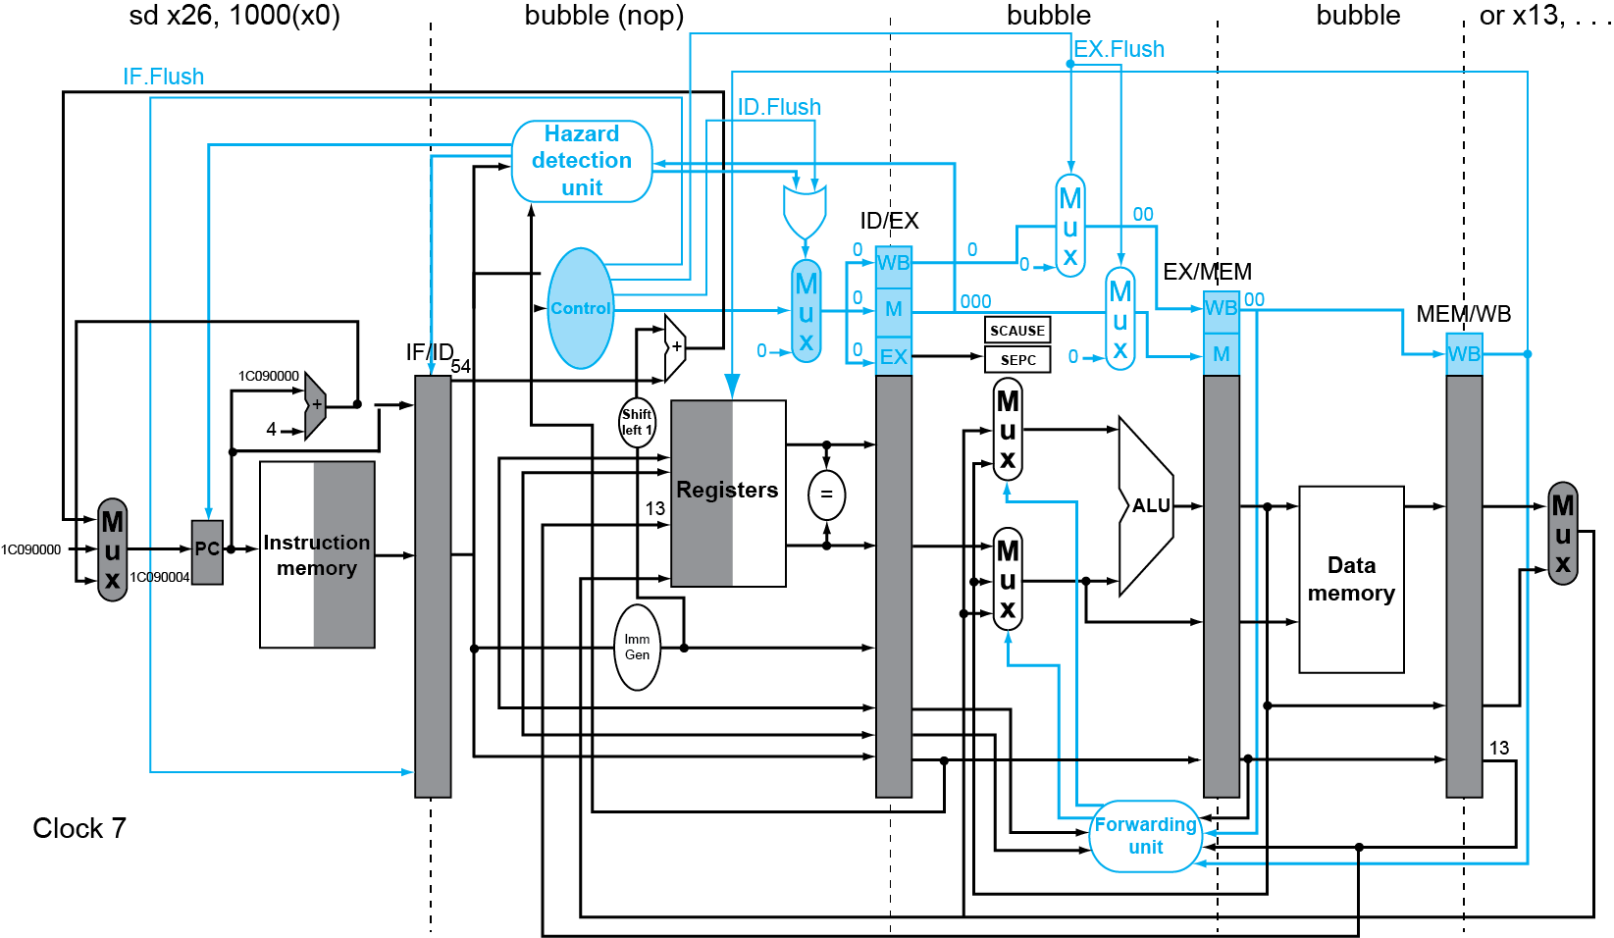
Exception Example
Chapter 4 — The Processor — <number>
Notes:
Morgan Kaufmann Publishers
Chapter 4 — The Processor

Slide 83
Multiple Exceptions
Pipelining overlaps multiple instructions
  Could have multiple exceptions at once
Simple approach: deal with exception from earliest instruction
  Flush subsequent instructions
  “Precise” exceptions
In complex pipelines
  Multiple instructions issued per cycle
  Out-of-order completion
  Maintaining precise exceptions is difficult!
Chapter 4 — The Processor — <number>
Notes:
Morgan Kaufmann Publishers
Chapter 4 — The Processor

Slide 84
Imprecise Exceptions
Just stop pipeline and save state
  Including exception cause(s)
Let the handler work out
  Which instruction(s) had exceptions
  Which to complete or flush
    May require “manual” completion
Simplifies hardware, but more complex handler software
Not feasible for complex multiple-issue
out-of-order pipelines
Chapter 4 — The Processor — <number>
Notes:
Morgan Kaufmann Publishers
Chapter 4 — The Processor

Slide 85
Instruction-Level Parallelism (ILP)
Pipelining: executing multiple instructions in parallel
To increase ILP
  Deeper pipeline
    Less work per stage ⇒ shorter clock cycle
  Multiple issue
    Replicate pipeline stages ⇒ multiple pipelines
    Start multiple instructions per clock cycle
    CPI < 1, so use Instructions Per Cycle (IPC)
    E.g., 4GHz 4-way multiple-issue
      16 BIPS, peak CPI = 0.25, peak IPC = 4
    But dependencies reduce this in practice
§4.11 Parallelism via Instructions
Chapter 4 — The Processor — <number>
Notes:
Morgan Kaufmann Publishers
Chapter 4 — The Processor

Slide 86
Multiple Issue
Static multiple issue
  Compiler groups instructions to be issued together
  Packages them into “issue slots”
  Compiler detects and avoids hazards
Dynamic multiple issue
  CPU examines instruction stream and chooses instructions to issue each cycle
  Compiler can help by reordering instructions
  CPU resolves hazards using advanced techniques at runtime
Chapter 4 — The Processor — <number>
Notes:
Morgan Kaufmann Publishers
Chapter 4 — The Processor

Slide 87
Speculation
“Guess” what to do with an instruction
  Start operation as soon as possible
  Check whether guess was right
    If so, complete the operation
    If not, roll-back and do the right thing
Common to static and dynamic multiple issue
Examples
  Speculate on branch outcome
    Roll back if path taken is different
  Speculate on load
    Roll back if location is updated
Chapter 4 — The Processor — <number>
Notes:
Morgan Kaufmann Publishers
Chapter 4 — The Processor

Slide 88
RISC-V with Static Dual Issue
Two-issue packets
  One ALU/branch instruction
  One load/store instruction
  64-bit aligned
    ALU/branch, then load/store
    Pad an unused instruction with nop
Address | Instruction type | Pipeline Stages
n | ALU/branch | IF | ID | EX | MEM | WB
n + 4 | Load/store | IF | ID | EX | MEM | WB
n + 8 | ALU/branch |  | IF | ID | EX | MEM | WB
n + 12 | Load/store |  | IF | ID | EX | MEM | WB
n + 16 | ALU/branch |  |  | IF | ID | EX | MEM | WB
n + 20 | Load/store |  |  | IF | ID | EX | MEM | WB
Chapter 4 — The Processor — <number>
Notes:
Morgan Kaufmann Publishers
Chapter 4 — The Processor

Slide 89
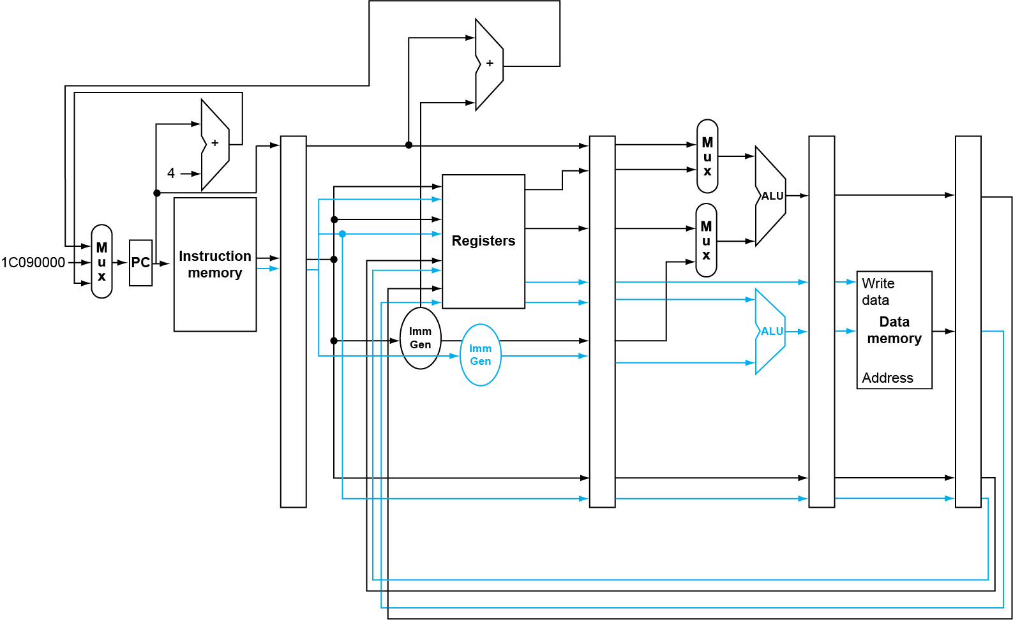
RISC-V with Static Dual Issue
Chapter 4 — The Processor — <number>
Notes:
Morgan Kaufmann Publishers
Chapter 4 — The Processor

Slide 90
Hazards in the Dual-Issue RISC-V
More instructions executing in parallel
EX data hazard
  Forwarding avoided stalls with single-issue
  Now can’t use ALU result in load/store in same packet
    add x10, x0, x1
    ld x2, 0(x10)
    Split into two packets, effectively a stall
Load-use hazard
  Still one cycle use latency, but now two instructions
More aggressive scheduling required
Chapter 4 — The Processor — <number>
Notes:
Morgan Kaufmann Publishers
Chapter 4 — The Processor

Slide 91
Scheduling Example
Schedule this for dual-issue RISC-V
Loop: ld x31,0(x20) // x31=array element
add x31,x31,x21 // add scalar in x21
sd x31,0(x20) // store result
addi x20,x20,-8 // decrement pointer
blt x22,x20,Loop // branch if x22 < x20
 | ALU/branch | Load/store | cycle
Loop: | nop | ld x31,0(x20) | 1
 | addi x20,x20,-8 | nop | 2
 | add x31,x31,x21 | nop | 3
 | blt x22,x20,Loop | sd x31,8(x20) | 4
  IPC = 5/4 = 1.25 (c.f. peak IPC = 2)
Chapter 4 — The Processor — <number>
Notes:
Morgan Kaufmann Publishers
Chapter 4 — The Processor

Slide 92
Loop Unrolling
Replicate loop body to expose more parallelism
  Reduces loop-control overhead
Use different registers per replication
  Called “register renaming”
  Avoid loop-carried “anti-dependencies”
    Store followed by a load of the same register
    Aka “name dependence”
      Reuse of a register name
Chapter 4 — The Processor — <number>
Notes:
Morgan Kaufmann Publishers
Chapter 4 — The Processor

Slide 93
Loop Unrolling Example
 | ALU/branch | Load/store | cycle
Loop: | addi x20,x20,-32 | ld x28, 0(x20) | 1
 | nop | ld x29, 24(x20) | 2
 | add x28,x28,x21 | ld x30, 16(x20) | 3
 | add x29,x29,x21 | ld x31, 8(x20) | 4
 | add x30,x30,x21 | sd x28, 32(x20) | 5
 | add x31,x31,x21 | sd x29, 24(x20) | 6
 | nop | sd x30, 16(x20) | 7
 | blt x22,x20,Loop | sd x31, 8(x20) | 8
IPC = 14/8 = 1.75
  Closer to 2, but at cost of registers and code size
Chapter 4 — The Processor — <number>
Notes:
Morgan Kaufmann Publishers
Chapter 4 — The Processor

Slide 94
Dynamic Multiple Issue
“Superscalar” processors
CPU decides whether to issue 0, 1, 2, … each cycle
  Avoiding structural and data hazards
Avoids the need for compiler scheduling
  Though it may still help
  Code semantics ensured by the CPU
Chapter 4 — The Processor — <number>
Notes:
Morgan Kaufmann Publishers
Chapter 4 — The Processor

Slide 95
Dynamic Pipeline Scheduling
Allow the CPU to execute instructions out of order to avoid stalls
  But commit result to registers in order
Example
  ld x31,20(x21)
  add x1,x31,x2
  sub x23,x23,x3
  andi x5,x23,20
  Can start sub while add is waiting for ld
Chapter 4 — The Processor — <number>
Notes:
Morgan Kaufmann Publishers
Chapter 4 — The Processor

Slide 96
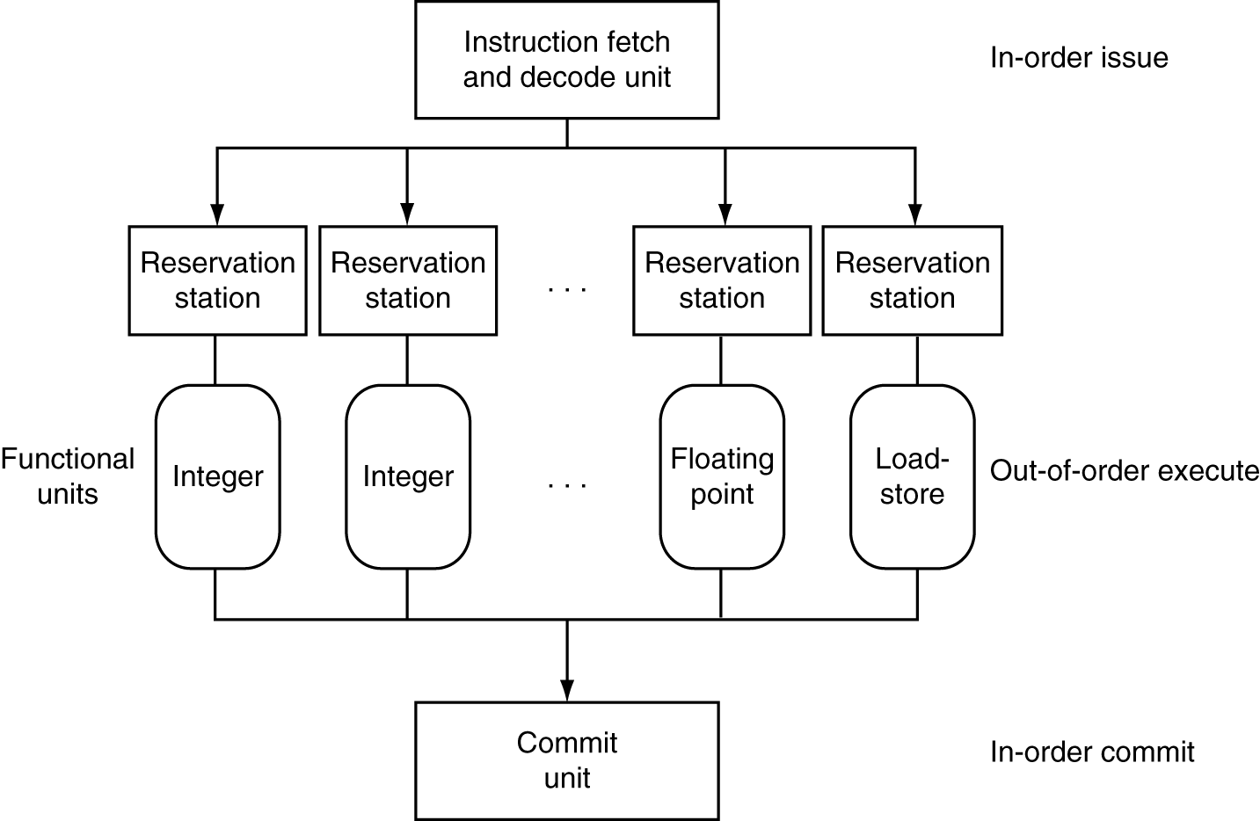
Dynamically Scheduled CPU
Preserves dependencies
Hold pending operands
Results also sent to any waiting reservation stations
Reorders buffer for register writes
Can supply operands for issued instructions
Chapter 4 — The Processor — <number>
Notes:
Morgan Kaufmann Publishers
Chapter 4 — The Processor

Slide 97
Why Do Dynamic Scheduling?
Why not just let the compiler schedule code?
Not all stalls are predicable
  e.g., cache misses
Can’t always schedule around branches
  Branch outcome is dynamically determined
Different implementations of an ISA have different latencies and hazards
Chapter 4 — The Processor — <number>
Notes:
Morgan Kaufmann Publishers
Chapter 4 — The Processor

Slide 98
Does Multiple Issue Work?
The BIG Picture
Yes, but not as much as we’d like
Programs have real dependencies that limit ILP
Some dependencies are hard to eliminate
  e.g., pointer aliasing
Some parallelism is hard to expose
  Limited window size during instruction issue
Memory delays and limited bandwidth
  Hard to keep pipelines full
Speculation can help if done well
Chapter 4 — The Processor — <number>
Notes:
Morgan Kaufmann Publishers
Chapter 4 — The Processor

Slide 99
Power Efficiency
Complexity of dynamic scheduling and speculations requires power
Multiple simpler cores may be better
Microprocessor | Year | Clock Rate | Pipeline Stages | Issue Width | Out-of-Order/ Speculation | Cores/ Chip | Power
Intel 486 | 1989 | 25 MHz | 5 | 1 | No | 1 | 5 W
Intel Pentium | 1993 | 66 MHz | 5 | 2 | No | 1 | 10 W
Intel Pentium Pro | 1997 | 200 MHz | 10 | 3 | Yes | 1 | 29 W
Intel Pentium 4 Willamette | 2001 | 2000 MHz | 22 | 3 | Yes | 1 | 75 W
Intel Pentium 4 Prescott | 2004 | 3600 MHz | 31 | 3 | Yes | 1 | 103 W
Intel Core | 2006 | 3000 MHz | 14 | 4 | Yes | 2 | 75 W
Intel Core i7 Nehalem | 2008 | 3600 MHz | 14 | 4 | Yes | 2-4 | 87 W
Intel Core Westmere | 2010 | 3730 MHz | 14 | 4 | Yes | 6 | 130 W
Intel Core i7 Ivy Bridge | 2012 | 3400 MHz | 14 | 4 | Yes | 6 | 130 W
Intel Core Broadwell | 2014 | 3700 MHz | 14 | 4 | Yes | 10 | 140 W
Intel Core i9 Skylake | 2016 | 3100 MHz | 14 | 4 | Yes | 14 | 165 W
Intel Ice Lake | 2018 | 4200 MHz | 14 | 4 | Yes | 16 | 185 W
Chapter 4 — The Processor — <number>
Notes:
Morgan Kaufmann Publishers
Chapter 4 — The Processor

Slide 100
Cortex A53 and Intel i7
Processor | ARM A53 | Intel Core i7 920
Market | Personal Mobile Device | Server, cloud
Thermal design power | 100 milliWatts (1 core @ 1 GHz) | 130 Watts
Clock rate | 1.5 GHz | 2.66 GHz
Cores/Chip | 4 (configurable) | 4
Floating point? | Yes | Yes
Multiple issue? | Dynamic | Dynamic
Peak instructions/clock cycle | 2 | 4
Pipeline stages | 8 | 14
Pipeline schedule | Static in-order | Dynamic out-of-order with speculation
Branch prediction | Hybrid | 2-level
1st level caches/core | 16-64 KiB I, 16-64 KiB D | 32 KiB I, 32 KiB D
2nd level caches/core | 128-2048 KiB | 256 KiB (per core)
3rd level caches (shared) | (platform dependent) | 2-8 MB
§4.12 Putting It All Together: The Intel Core i7 6700 and ARM Corex-A53
Chapter 4 — The Processor — <number>

Slide 101
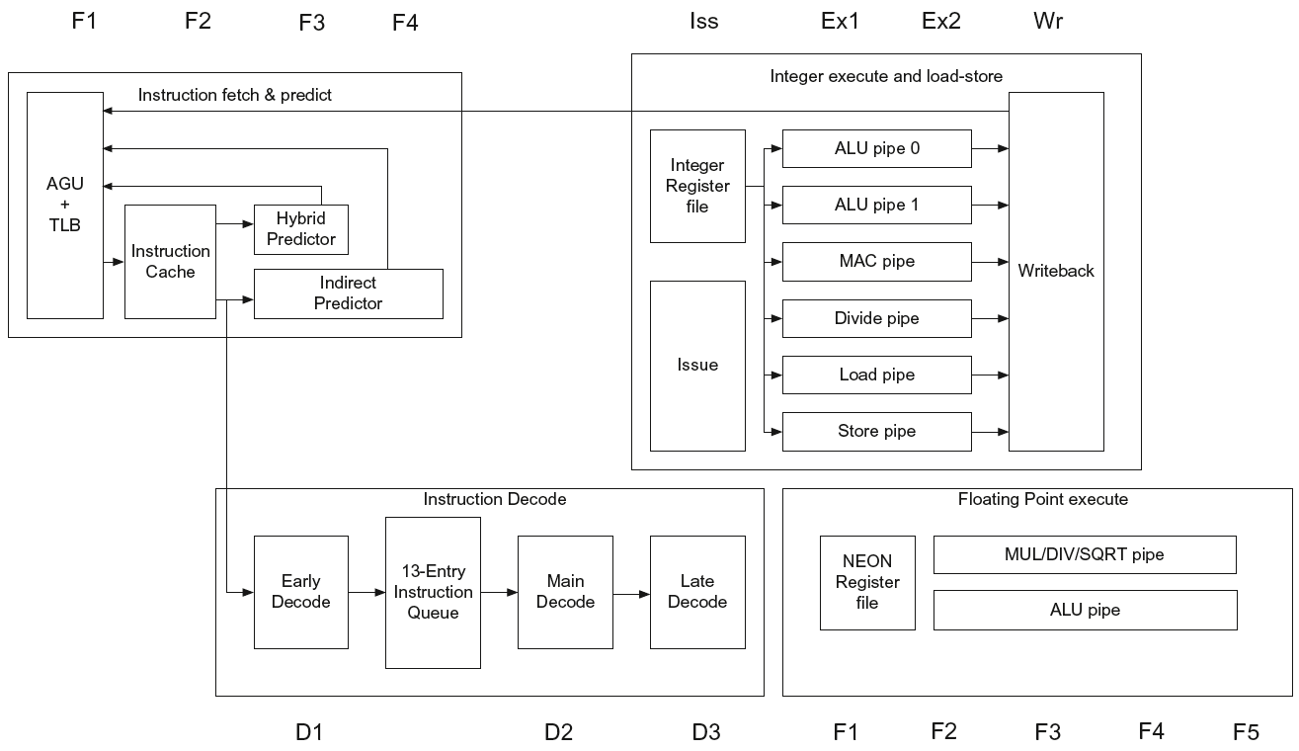
ARM Cortex-A53 Pipeline
Chapter 4 — The Processor — <number>

Slide 102
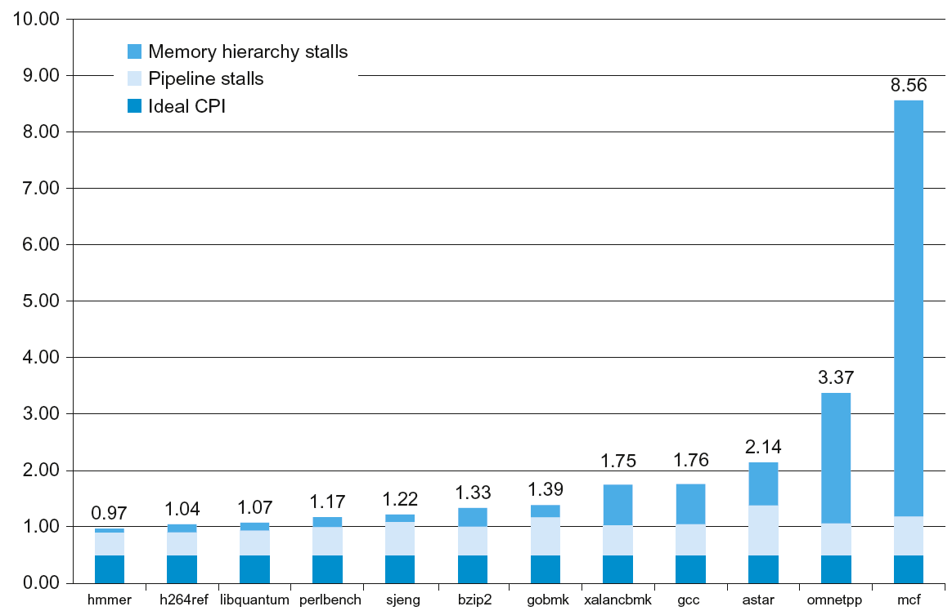
ARM Cortex-A53 Performance
Chapter 4 — The Processor — <number>

Slide 103
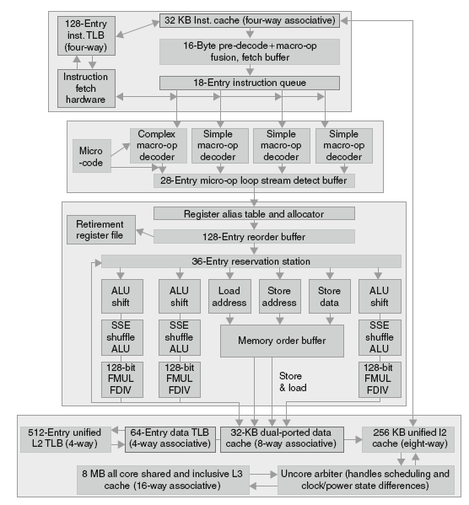
Core i7 Pipeline
Chapter 4 — The Processor — <number>

Slide 104
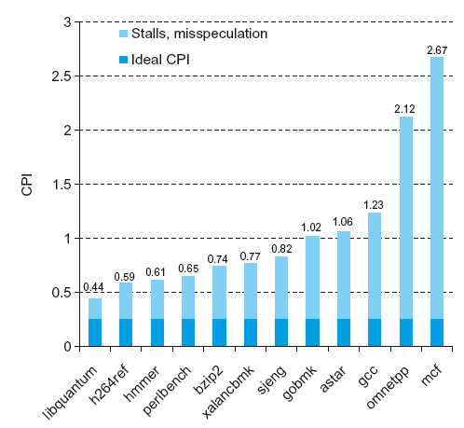
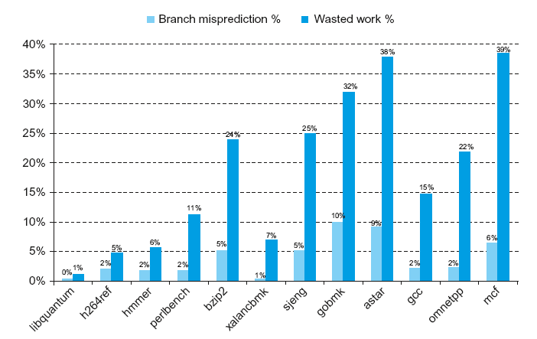
Core i7 Performance
Chapter 4 — The Processor — <number>

Slide 105
Matrix Multiply
Unrolled C code
1. #include <x86intrin.h>
2. #define UNROLL (4)
3.
4. void dgemm (int n, double* A, double* B, double* C)
5. {
6. for (int i = 0; i < n; i+=UNROLL*8)
7. for (int j = 0; j < n; ++j){
8. __m512d c[UNROLL];
9. for (int r=0;r<UNROLL;r++)
10. c[r] = _mm512_load_pd(C+i+r*8+j*n); //[ UNROLL];
11.
12. for( int k = 0; k < n; k++ )
13. {
14. __m512d bb = _mm512_broadcastsd_pd(_mm_load_sd(B+j*n+k));
15. for (int r=0;r<UNROLL;r++)
16. c[r] = _mm512_fmadd_pd(_mm512_load_pd(A+n*k+r*8+i), bb, c[r]);
17. }
18.
19. for (int r=0;r<UNROLL;r++)
20. _mm512_store_pd(C+i+r*8+j*n, c[r]);
21. }
22. }
§4.13 Going Faster: Instruction-Level Parallelism and Matrix Multiply
Chapter 4 — The Processor — <number>

Slide 106
Matrix Multiply
Assembly code:
vmovapd (%r11),%zmm4 # Load 8 elements of C into %zmm4
mov %rbx,%rcx # register %rcx = %rbx
xor %eax,%eax # register %eax = 0
vmovapd 0x20(%r11),%zmm3 # Load 8 elements of C into %zmm3
vmovapd 0x40(%r11),%zmm2 # Load 8 elements of C into %zmm2
vmovapd 0x60(%r11),%zmm1 # Load 8 elements of C into %zmm1
vbroadcastsd (%rax,%r8,8),%zmm0 # Make 8 copies of B element in %zmm0
add $0x8,%rax # register %rax = %rax + 8
vfmadd231pd (%rcx),%zmm0,%zmm4 # Parallel mul & add %zmm0, %zmm4
vfmadd231pd 0x20(%rcx),%zmm0,%zmm3 # Parallel mul & add %zmm0, %zmm3
vfmadd231pd 0x40(%rcx),%zmm0,%zmm2 # Parallel mul & add %zmm0, %zmm2
vfmadd231pd 0x60(%rcx),%zmm0,%zmm1 # Parallel mul & add %zmm0, %zmm1
add %r9,%rcx # register %rcx = %rcx
cmp %r10,%rax # compare %r10 to %rax
jne 50 <dgemm+0x50> # jump if not %r10 != %rax
add $0x1, %esi # register % esi = % esi + 1
vmovapd %zmm4, (%r11) # Store %zmm4 into 8 C elements
vmovapd %zmm3, 0x20(%r11) # Store %zmm3 into 8 C elements
vmovapd %zmm2, 0x40(%r11) # Store %zmm2 into 8 C elements
vmovapd %zmm1, 0x60(%r11) # Store %zmm1 into 8 C elements
Chapter 4 — The Processor — <number>

Slide 107
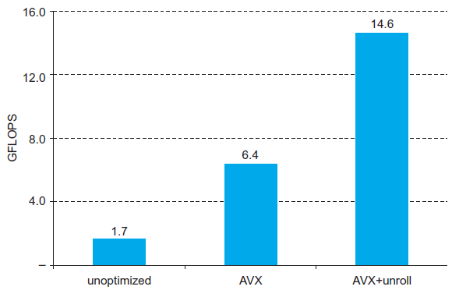
Performance Impact
Chapter 4 — The Processor — <number>

Slide 108
Fallacies
Pipelining is easy (!)
  The basic idea is easy
  The devil is in the details
    e.g., detecting data hazards
Pipelining is independent of technology
  So why haven’t we always done pipelining?
  More transistors make more advanced techniques feasible
  Pipeline-related ISA design needs to take account of technology trends
    e.g., predicated instructions
§4.15 Fallacies and Pitfalls
Chapter 4 — The Processor — <number>
Notes:
Morgan Kaufmann Publishers
Chapter 4 — The Processor

Slide 109
Pitfalls
Poor ISA design can make pipelining harder
  e.g., complex instruction sets (VAX, IA-32)
    Significant overhead to make pipelining work
    IA-32 micro-op approach
  e.g., complex addressing modes
    Register update side effects, memory indirection
  e.g., delayed branches
    Advanced pipelines have long delay slots
Chapter 4 — The Processor — <number>
Notes:
Morgan Kaufmann Publishers
Chapter 4 — The Processor

Slide 110
Concluding Remarks
ISA influences design of datapath and control
Datapath and control influence design of ISA
Pipelining improves instruction throughput
using parallelism
  More instructions completed per second
  Latency for each instruction not reduced
Hazards: structural, data, control
Multiple issue and dynamic scheduling (ILP)
  Dependencies limit achievable parallelism
  Complexity leads to the power wall
§4.16 Concluding Remarks
Chapter 4 — The Processor — <number>
Notes:
Morgan Kaufmann Publishers
Chapter 4 — The Processor

Slide 111
Homework
4.20
4.22.1
4.24
4.29.1, 4.29.2, 4.29.3
Chapter 4 — The Processor — <number>

